Slide 1
To update list (15 July 2024)
From page 35, 41
Update RL ERP plot (see FDI VS BCP diff)
Check LRP C3 C4 -> next step compare location
Motor pre signal

Slide 2
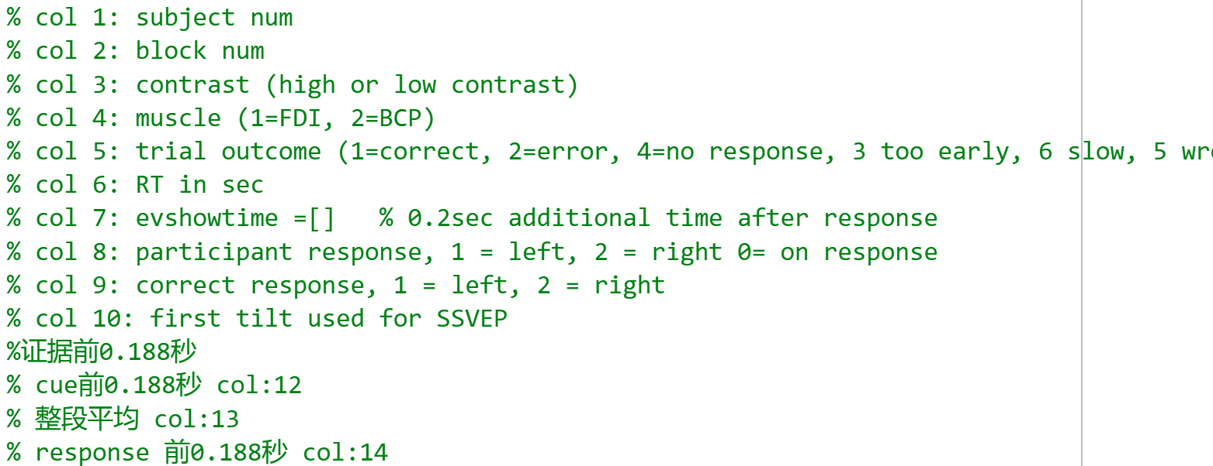
All analysis Exclude invalided trials when too early and wrong muscle CPP channel: 19

Slide 3

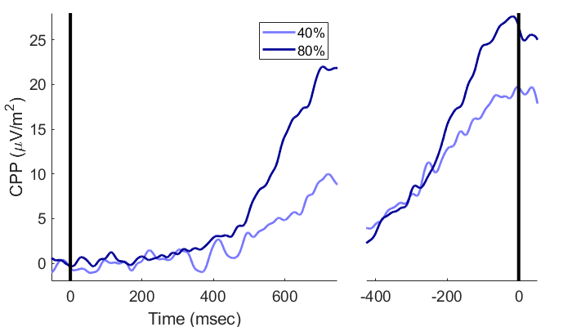
SL pre-cue -188ms (CW / HL) SL pre-evidence -188ms (FB)
Correct vs wrong
FDI vs BCP
High vs Low

Slide 4
Correct Vs wrong(SL_b)
Drift rate different since ‘evidence on’
After response amplitude drops faster
Lowest at response time
(from scalp plots) correct have clearer CPP burst around 300-900 than wrong
(from scalp plots) same amplitude; but correct CPP moves more to centre from 300-900
Notes:
EEG_sorting_plot_SL_b.m

Slide 5
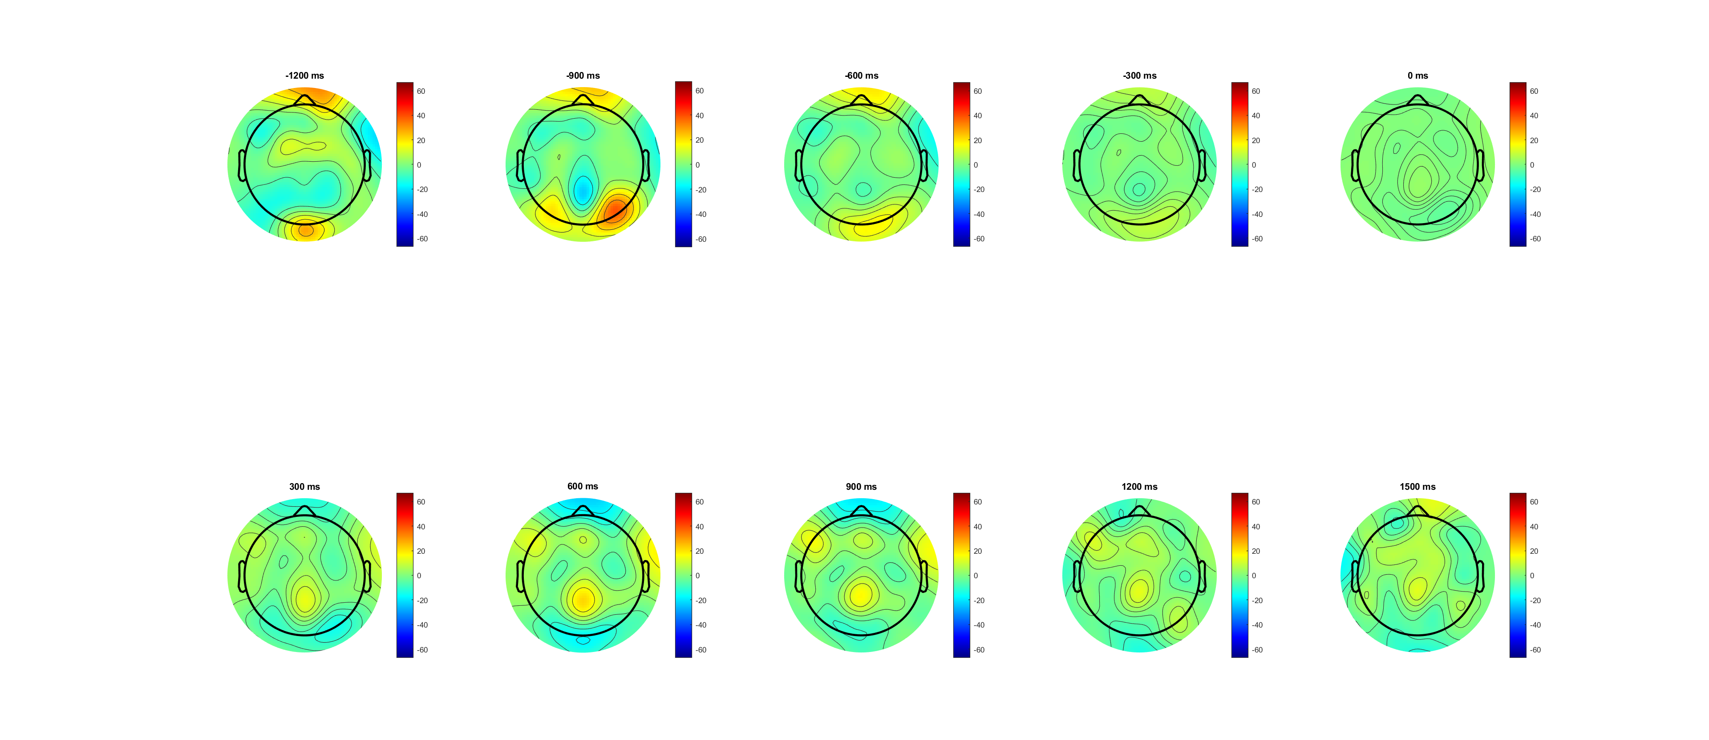
Correct (-1200:1500) pre evd

Slide 6
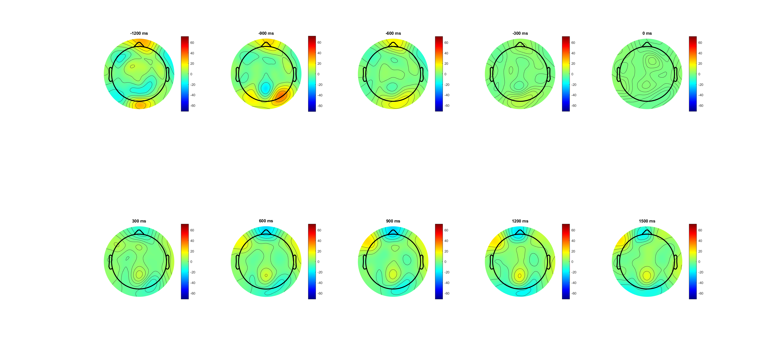
Wrong (-1200:1500) pre evd

Slide 7
Correct Vs wrong(SL pre-cue -188ms) amplitude larger
Drift rate different since ‘evidence on’
After min evidence amplitude drops faster
Lowest at response time
(from scalp plots) correct have clearer CPP burst around 300-900 than wrong
(from scalp plots) same amplitude; but correct CPP moves more to centre from 300-900
* trial number 4:1
C1 (at baseline on)
SSVEP (after baseline on)
Emergency (300ms after cue change)
Drift rate diff (after EVon);
Peak around 500
Drop after decision/ action; maintain if wrong
Second peak after DDL1.5 (Emergency caused by time pressure?)
Notes:
EEG_sorting_plot_SL_bb.m

Slide 8
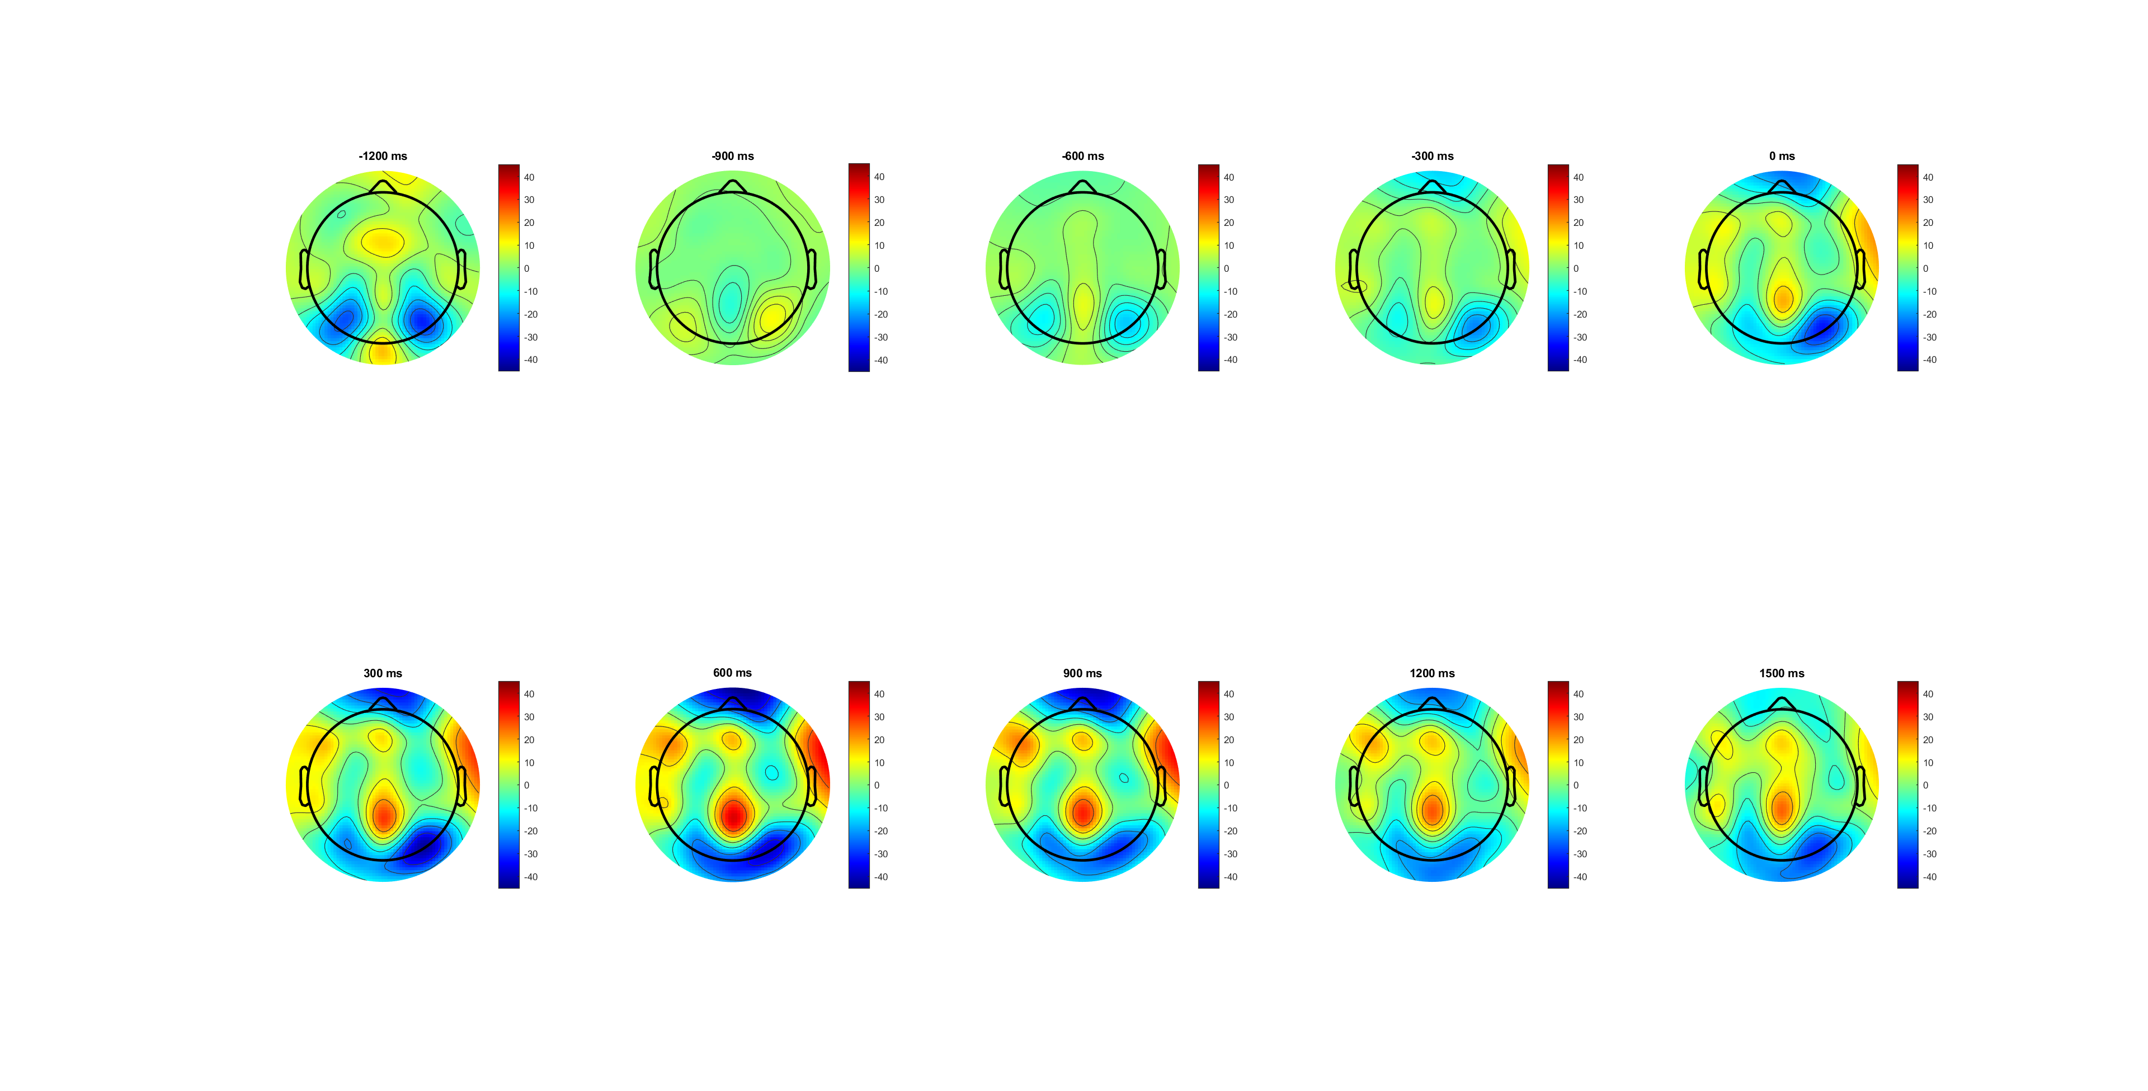
Correct (-1200:1500) pre cue
CPP seems start -600(after cue),
peak at 600
Move from partial to centra?

Slide 9
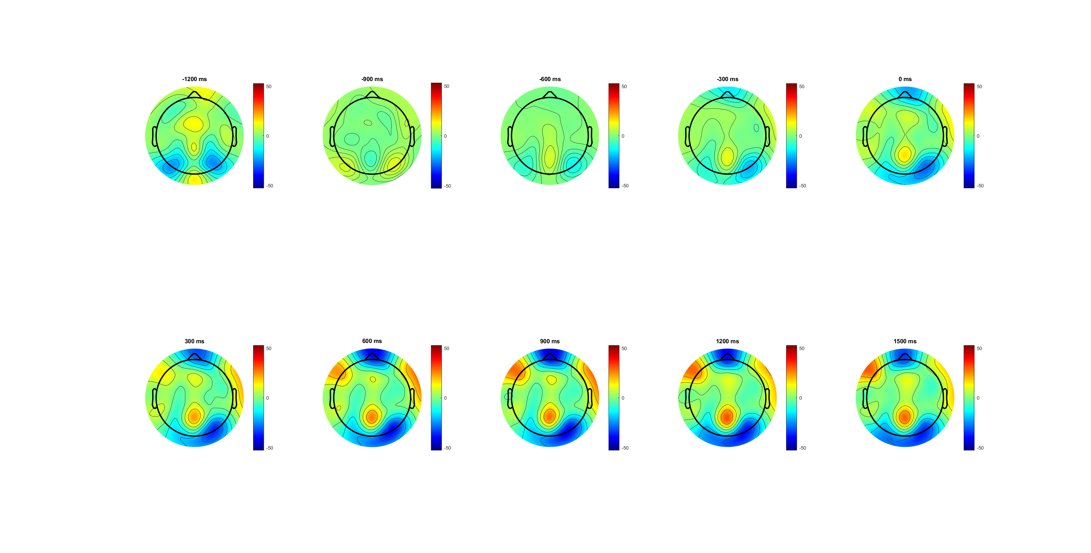
Wrong (-1200:1500) pre cue
CPP seems start -600(after cue),
Maintain for the rest
Location not moving

Slide 10
High Vs Low(SL_bb)
Low is more like wrong condition
pre-cue baseline (seems already acc before evidence)
(from scalp plots) high is more observious
Emergency/ACC (300ms after cue change)- only for high??
Drift rate diff (after EVon);
Peak around 500 ; -only high
Drop after decision/ action; maintain for low
Second peak after DDL1.5 (Emergency caused by time pressure?) -both
Notes:
EEG_sorting_plot_SL_bb.m

Slide 11
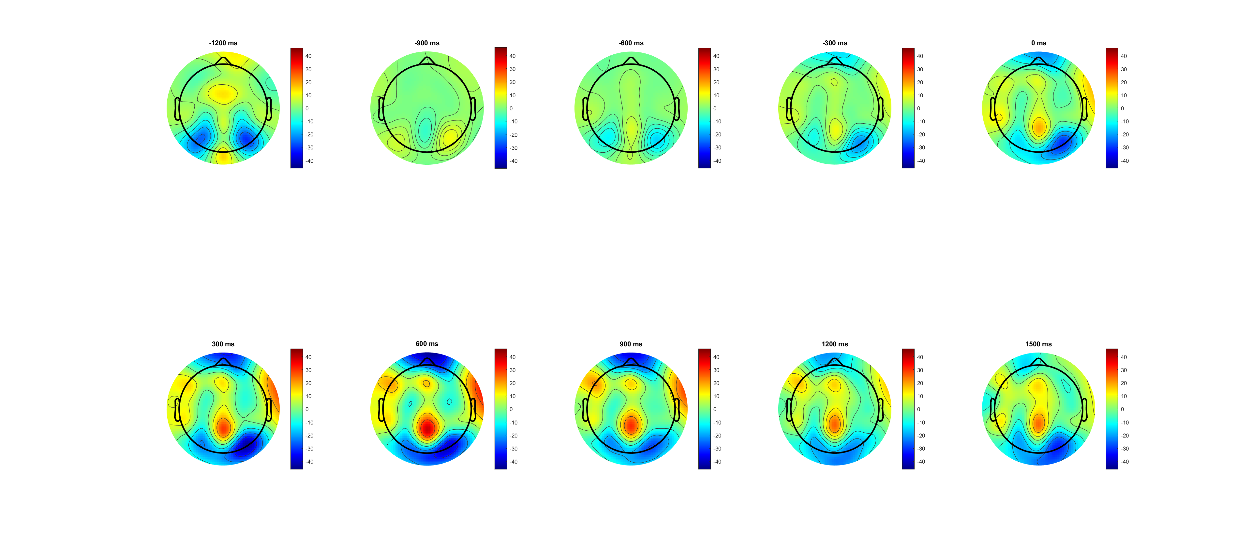
High,0.14 (-1200:1500) pre cue
Deeper CPP
Move from partial to centra

Slide 12
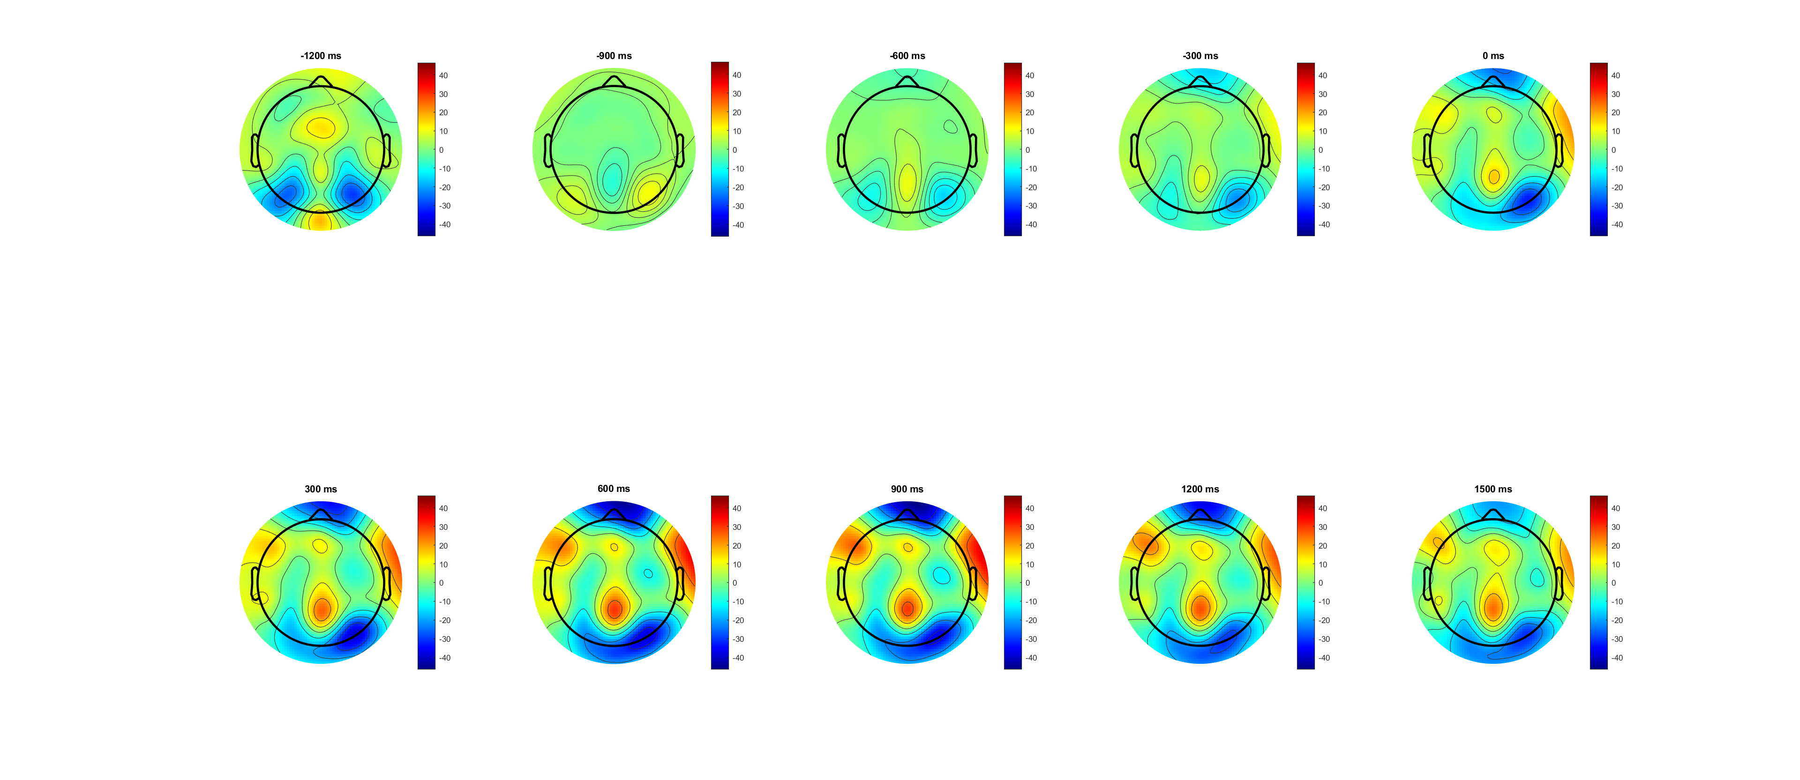
Low,0.07 (-1200:1500) pre cue
less CPP
Not moving

Slide 13
High Vs Low(SL_b)
Low is more like wrong condition
Should check in pre-cue baseline (seems already acc before evidence)
(from scalp plots) high is more observious
Notes:
EEG_sorting_plot_SL_b.m

Slide 14
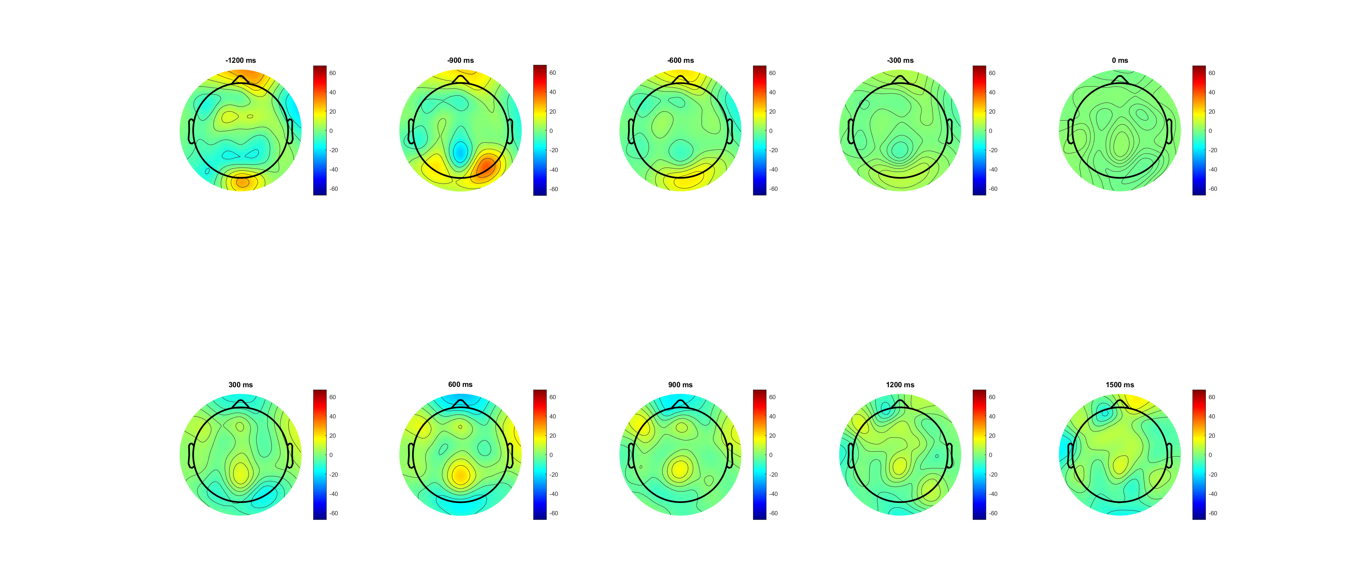
High,0.14 (-1200:1500) pre evidence

Slide 15
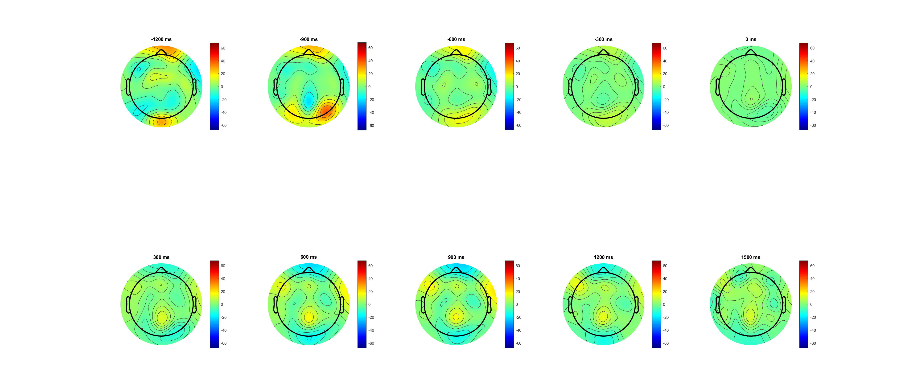
Low,0.07 (-1200:1500) pre evidence

Slide 16
FDI Vs BCP(ERP more clear in pre evidence plot)
Overall BCP lower than FDI!!! But higher between 1.5 and 2
Drift rate slightly different since ‘evidence on’
Lowest at response time
(from scalp plots) FDI slightly stronger!
Drift rate diff (after EVon);
Peak around 500 ; BCP drop slop faster
BCP slop raise after DDL 15 (emergency due to time pressure?)
Where 123 come from- look deeper
Notes:
EEG_sorting_plot_SL_b.m

Slide 17
Pre cue
Not observious
Notes:
Pre cue

Slide 18
FDI vs BCP correct(L) wrong(R)
Overall BCP lower than FDI!!!
But higher between 1.5 and 2 (mainly from wrong trials)
Notes:
Pre evidence

Slide 19
FDI vs BCP correct(L) wrong(R)
Overall BCP lower than FDI!!!
But higher between 1.5 and 2 (mainly from wrong trials)
Notes:
Pre cue

Slide 20
FDI vs BCP correct high(0.14 left) low (0.07) right
Among correct trials
The higher FDI in period (0 800) mainly comes from high contrast/ slightly from low
The higher FDI in period (800 1500) mainly come from low
Notes:
Pre evd

Slide 21
FDI vs BCP correct high(0.14 left) low (0.07) right
Among correct trials
The higher FDI in period (0 800) mainly comes from high contrast
The higher FDI in period (800 1500) mainly come from low
Notes:
Pre cue

Slide 22

FDI vs BCP wrong high(0.14 left) low (0.07 right)
Among wrong trials (192trial vs 197 trial? Still available?)
BCP always higher in ‘high’ after evidence finish (less Com?)
Notes:
Pre evd

Slide 23
FDI vs BCP wrong high(0.14 left) low (0.07 right)
Among wrong trials (192trial vs 197 trial? Still available?)
BCP always higher in ‘high’ after evidence finish (less Com?)
Notes:
Pre cue

Slide 24
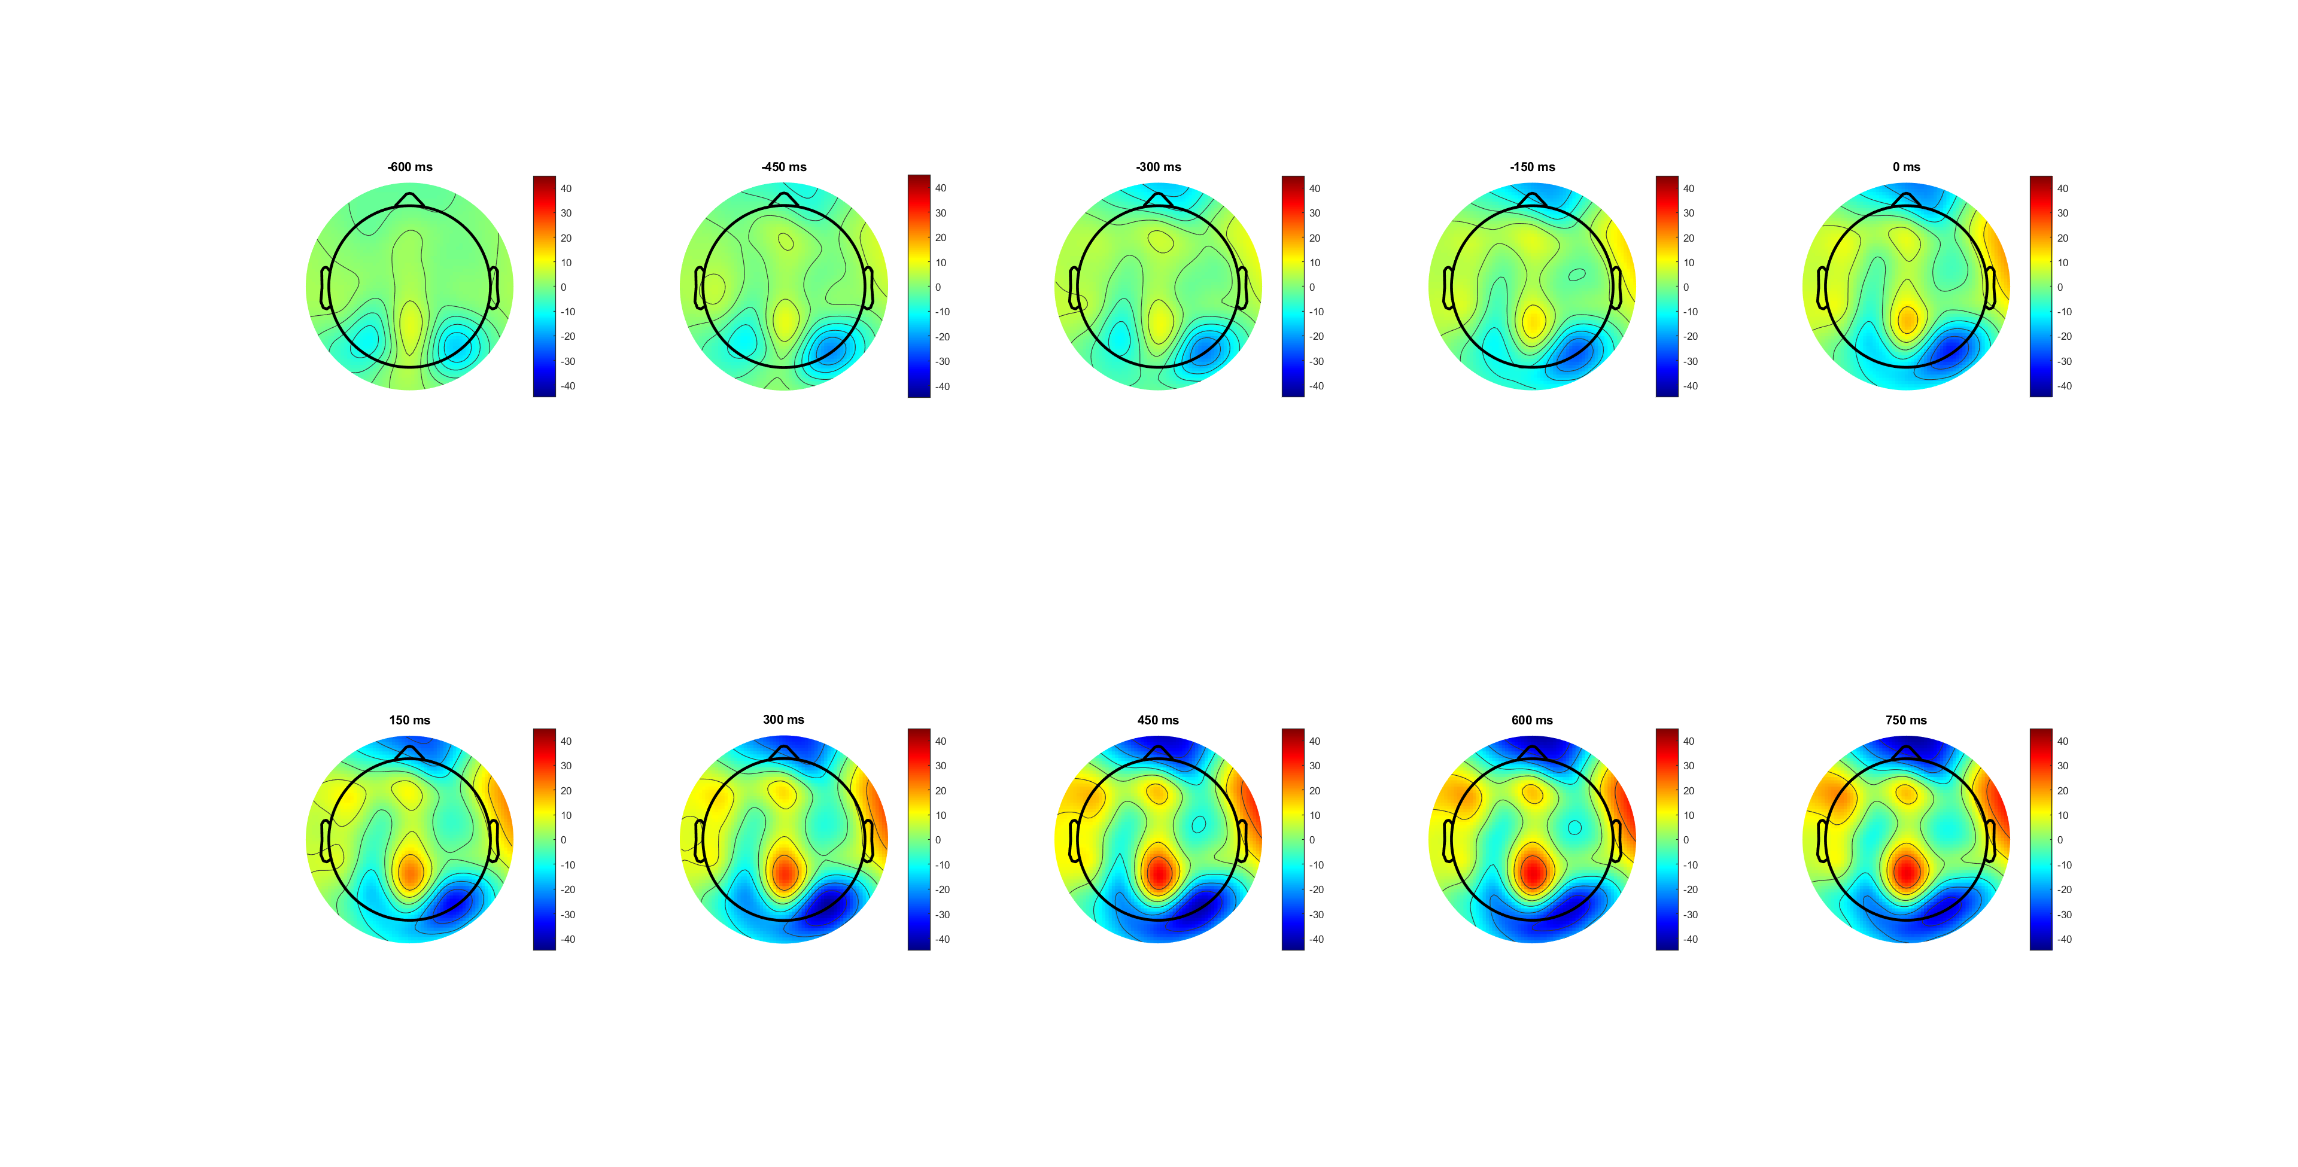
FDI (-600:750) pre cue
Slightly more CPP
Not moving

Slide 25
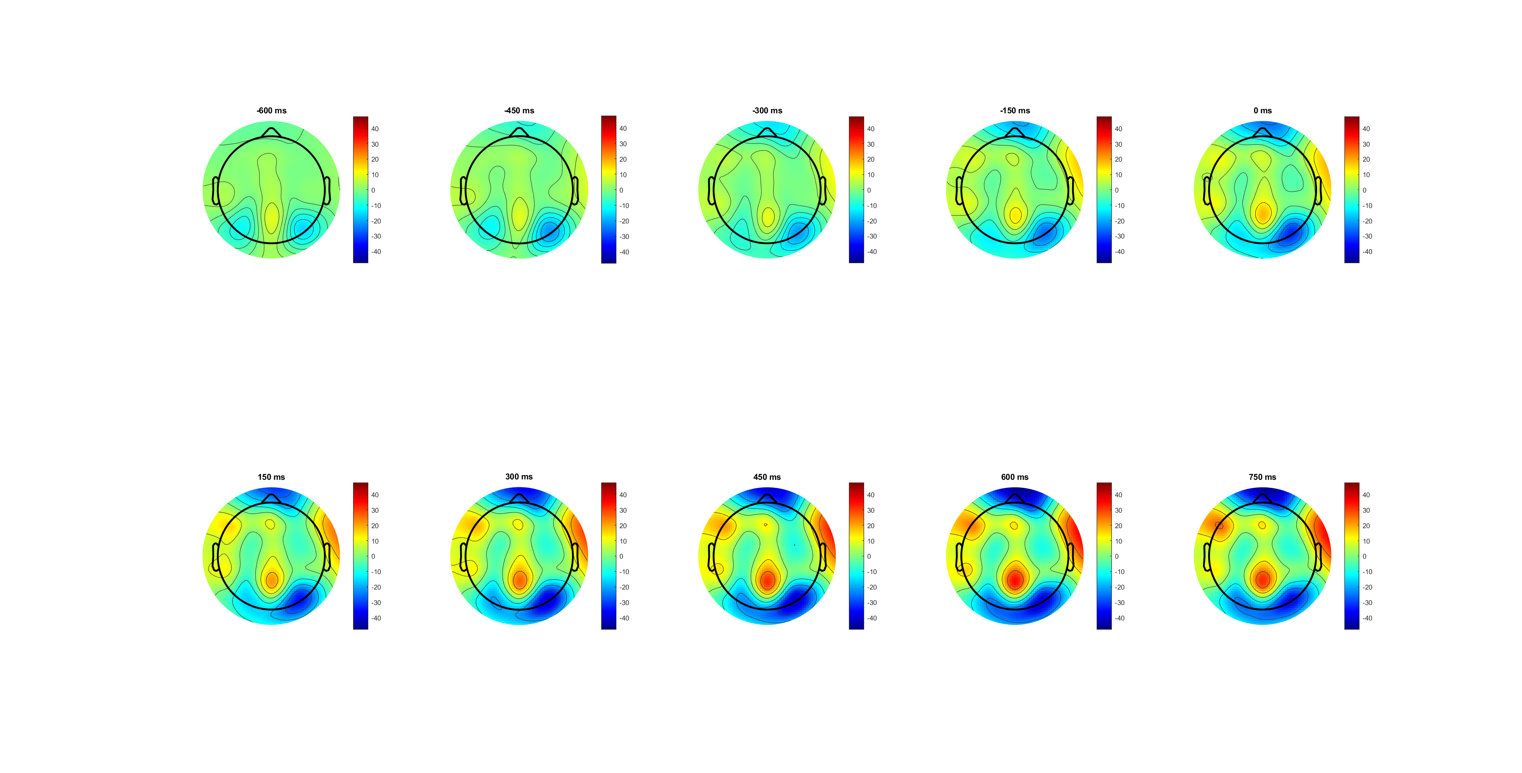
BCP (-600:750) pre cue
Slightly less CPP
Not moving

Slide 26
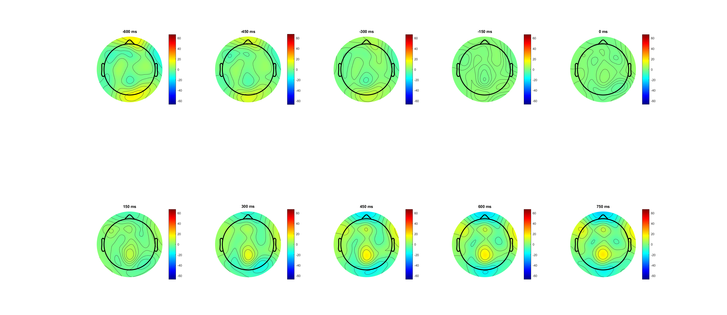
FDI (-600:750) pre evidence

Slide 27
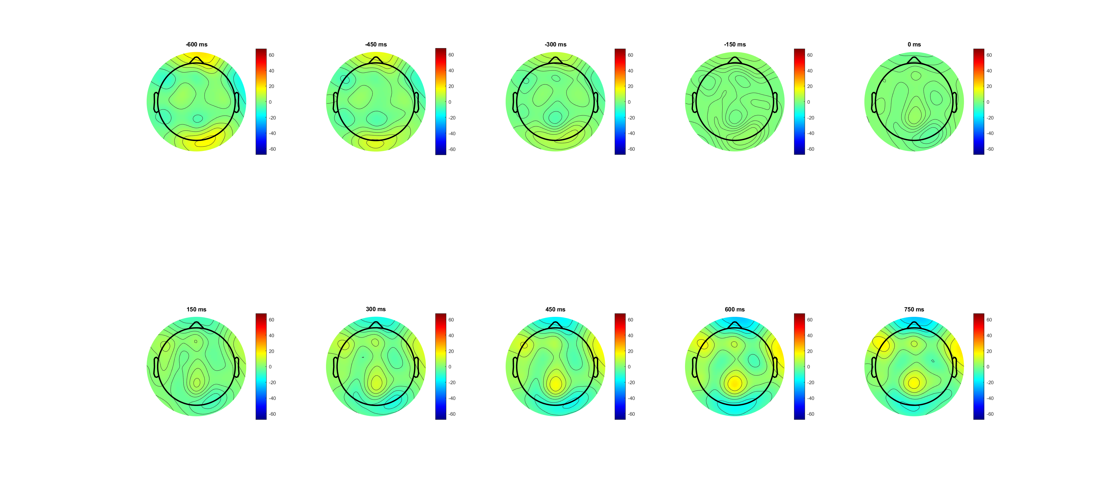
BCP (-600:750) pre evidence

Slide 28
RL_bb pre-Feedback -188ms (FB) pre_cue -188ms (used now)
Correct vs wrong
FDI vs BCP
High vs Low

Slide 29
Correct Vs Wrong (-188 before cue)
Correct is much higher
Peak before response and drop?? (drop 300ms before EVoff)； response at 200
After wrong higher (post EMG) because of surprise?
post EVOFF depolarization??
Notes:
EEG_sorting_plot_SL_bb.m

Slide 30
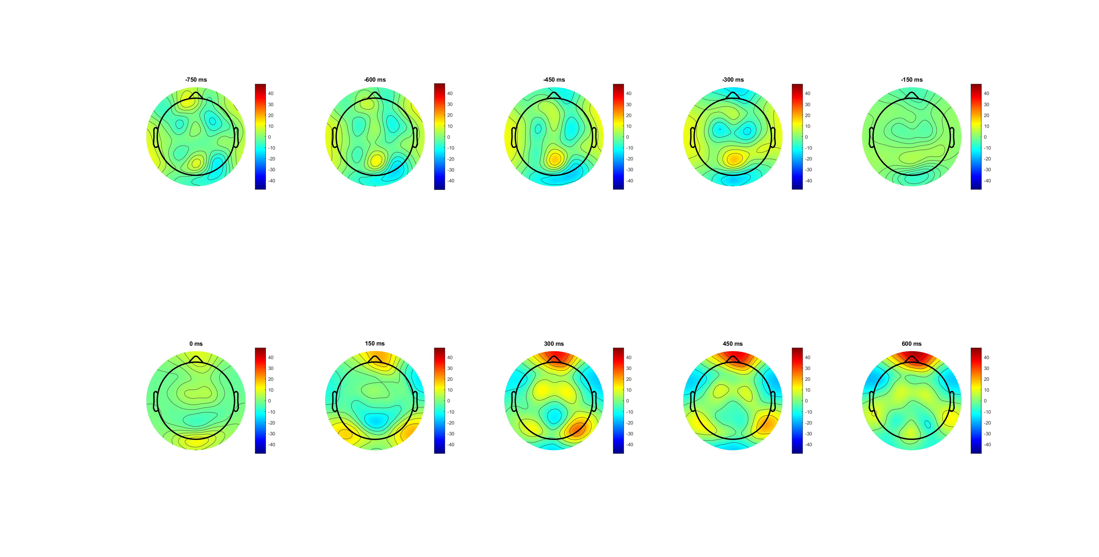
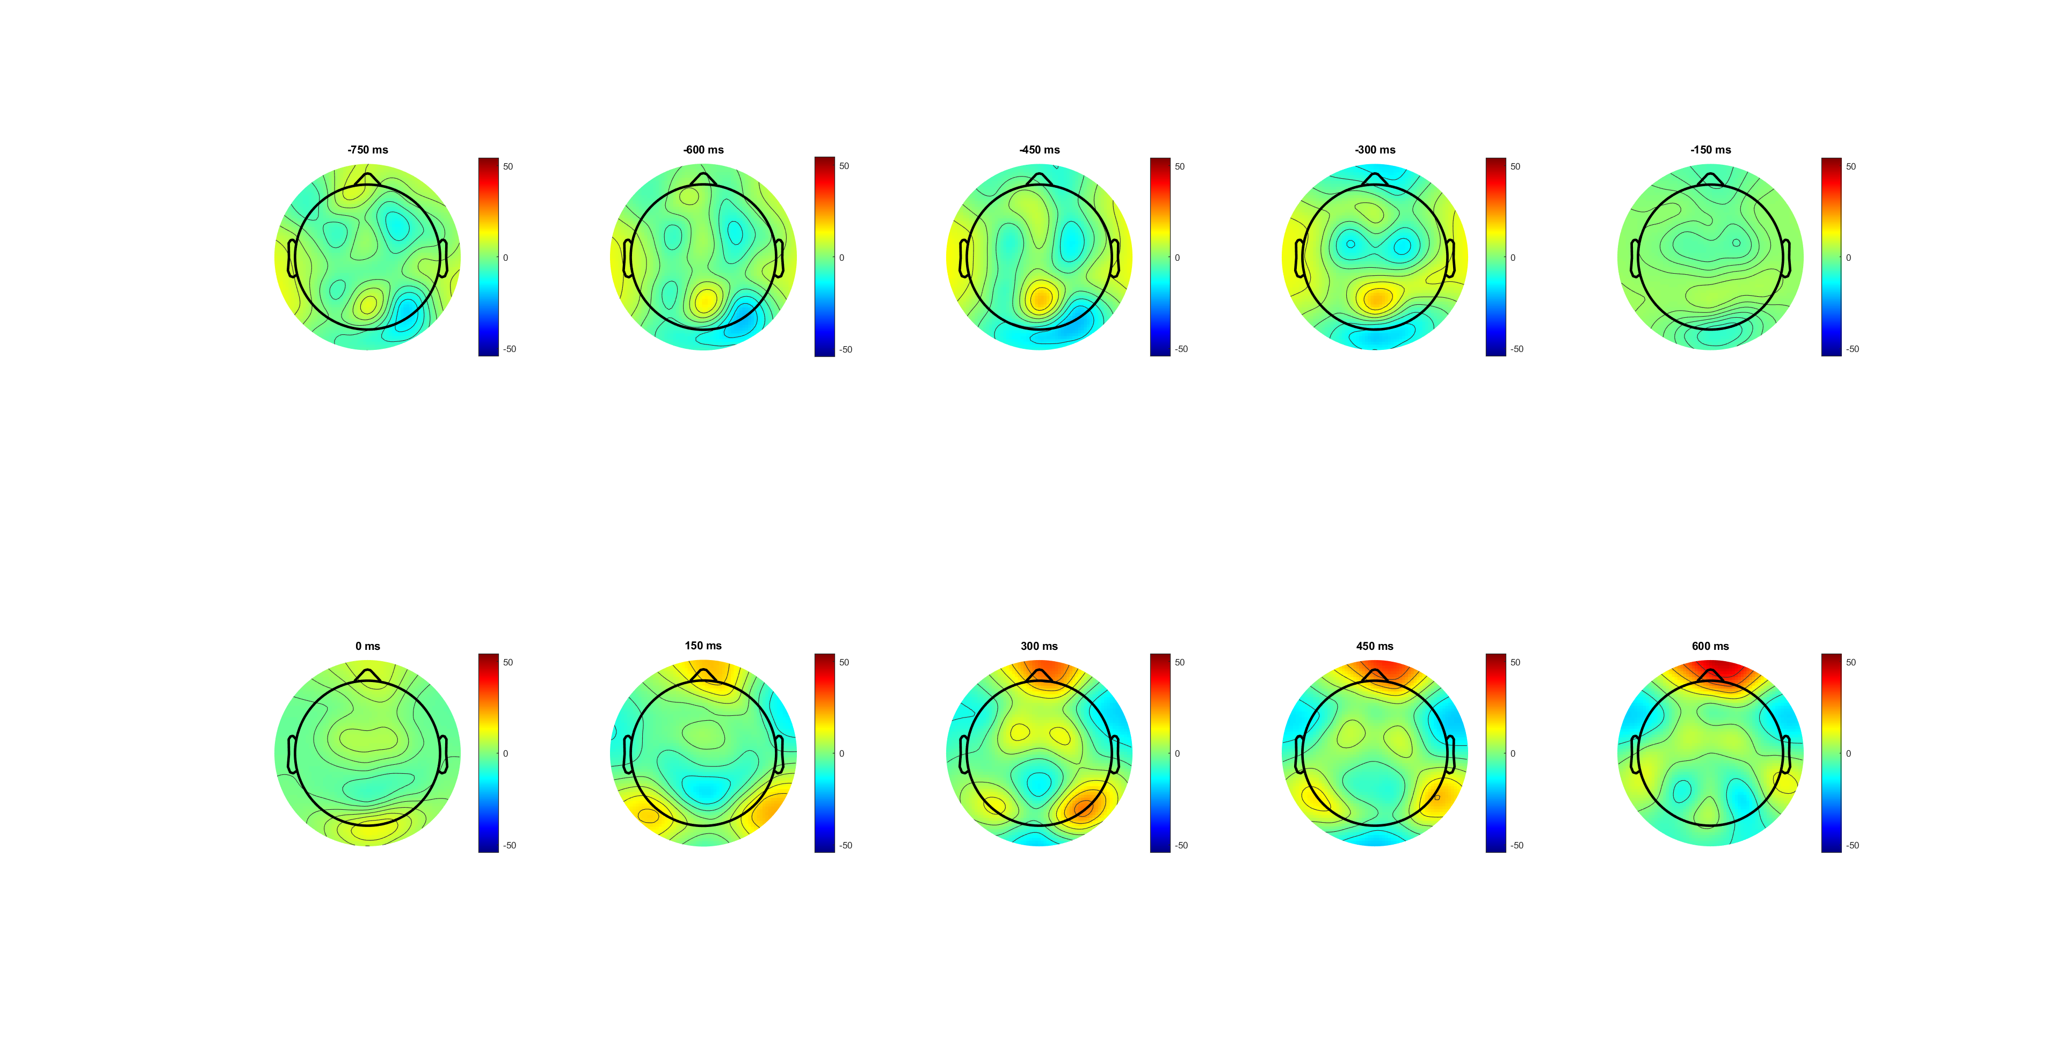
correct (-750:600) see -300(CPP) post EVOFF depolarization??

Slide 31
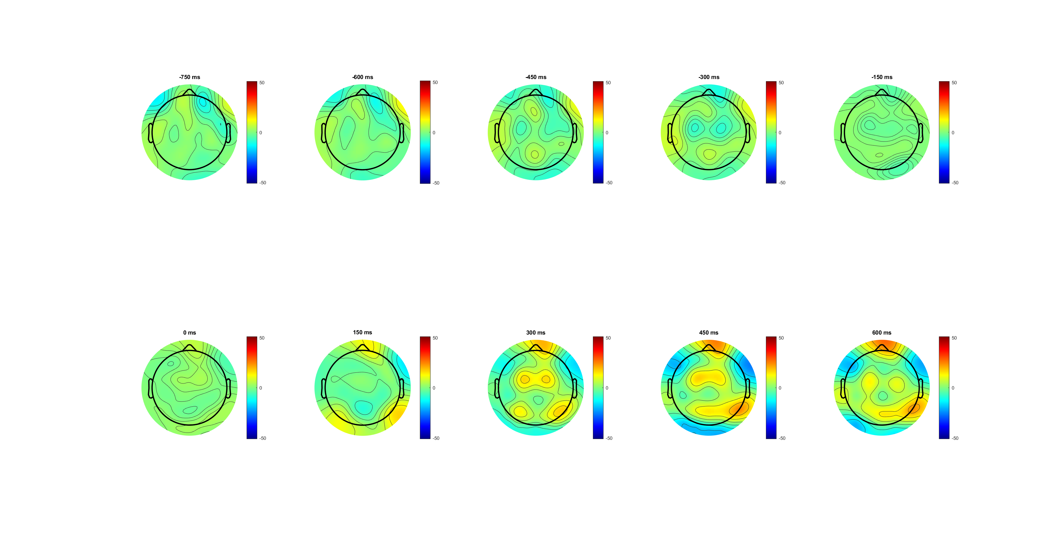
wrong (-750:600) see -300 no CPP

Slide 32
High vs low (-188 before cue)
No observes diff
High has slightly higher peak
Peak before response and drop?? (drop 300ms before EVoff)
Similar scalp plot
Notes:
EEG_sorting_plot_SL_bb.m

Slide 33
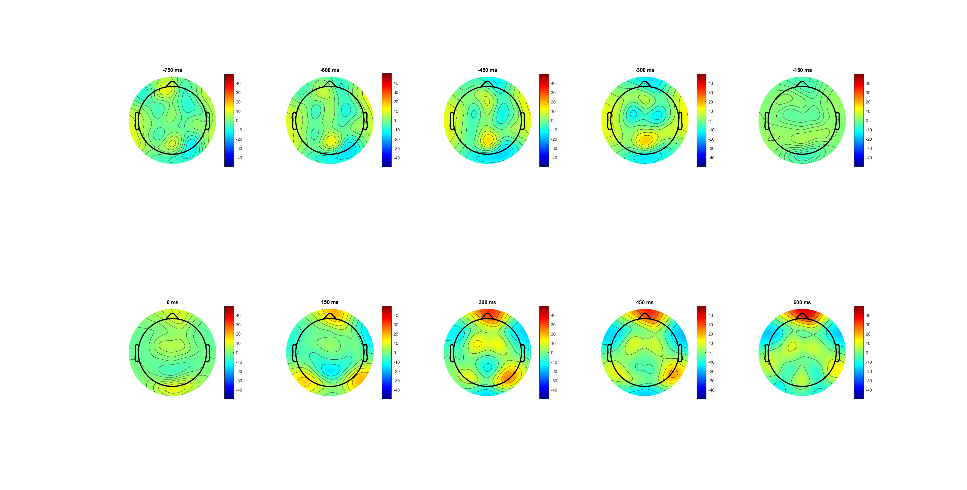
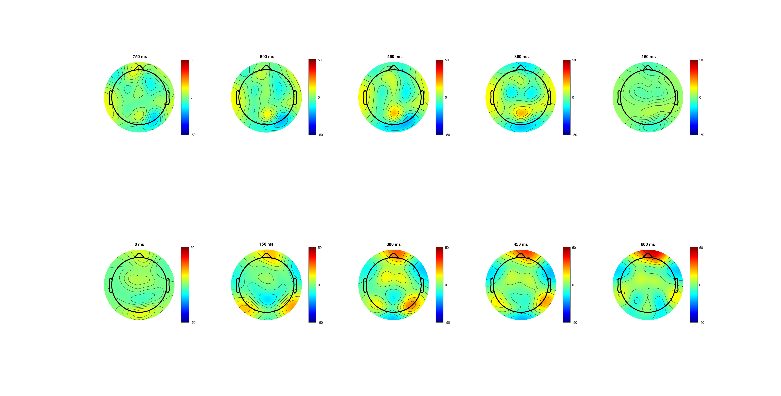
high (-750:600) see -300(CPP)

Slide 34
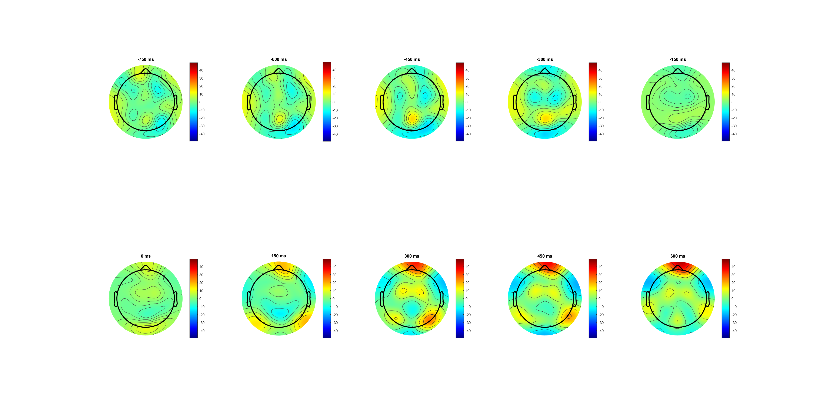
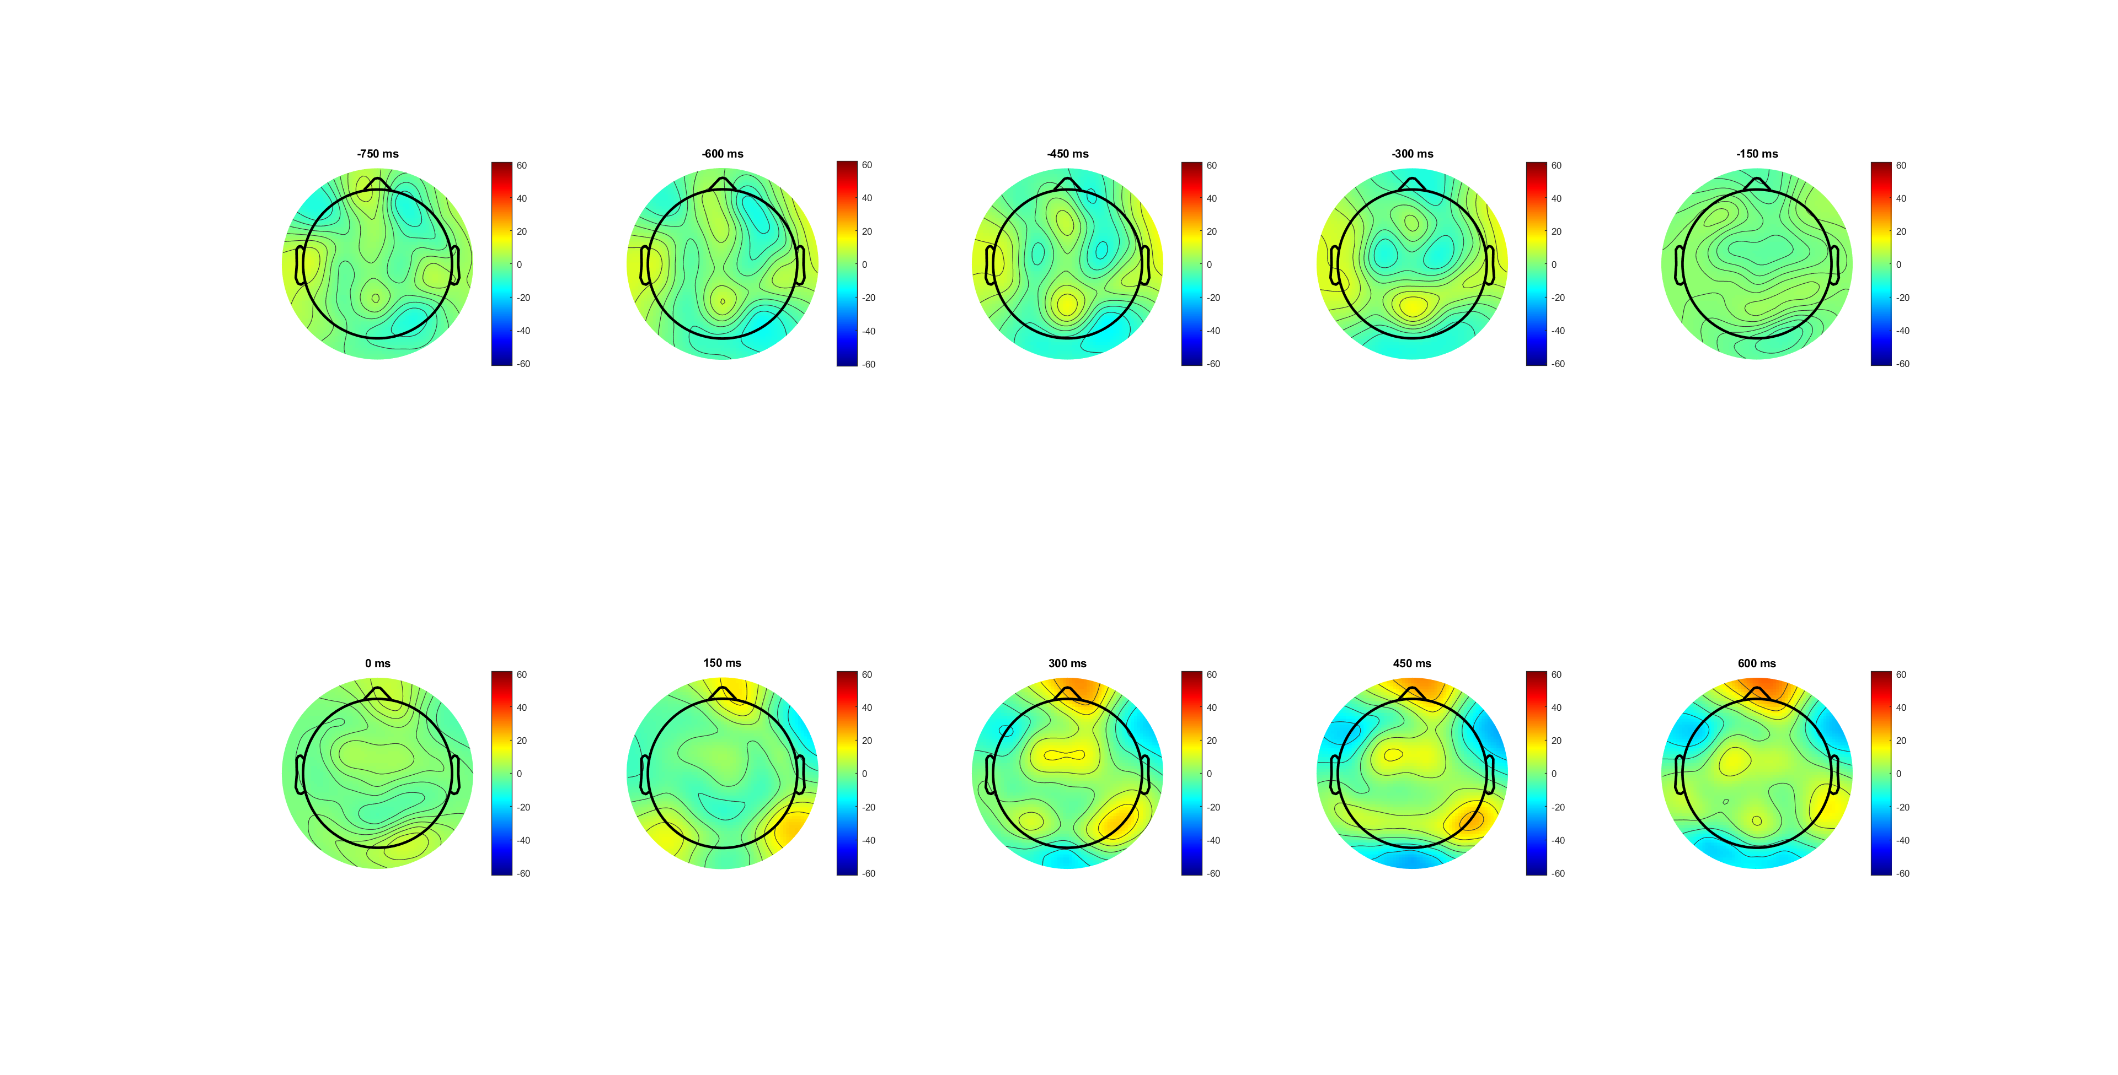
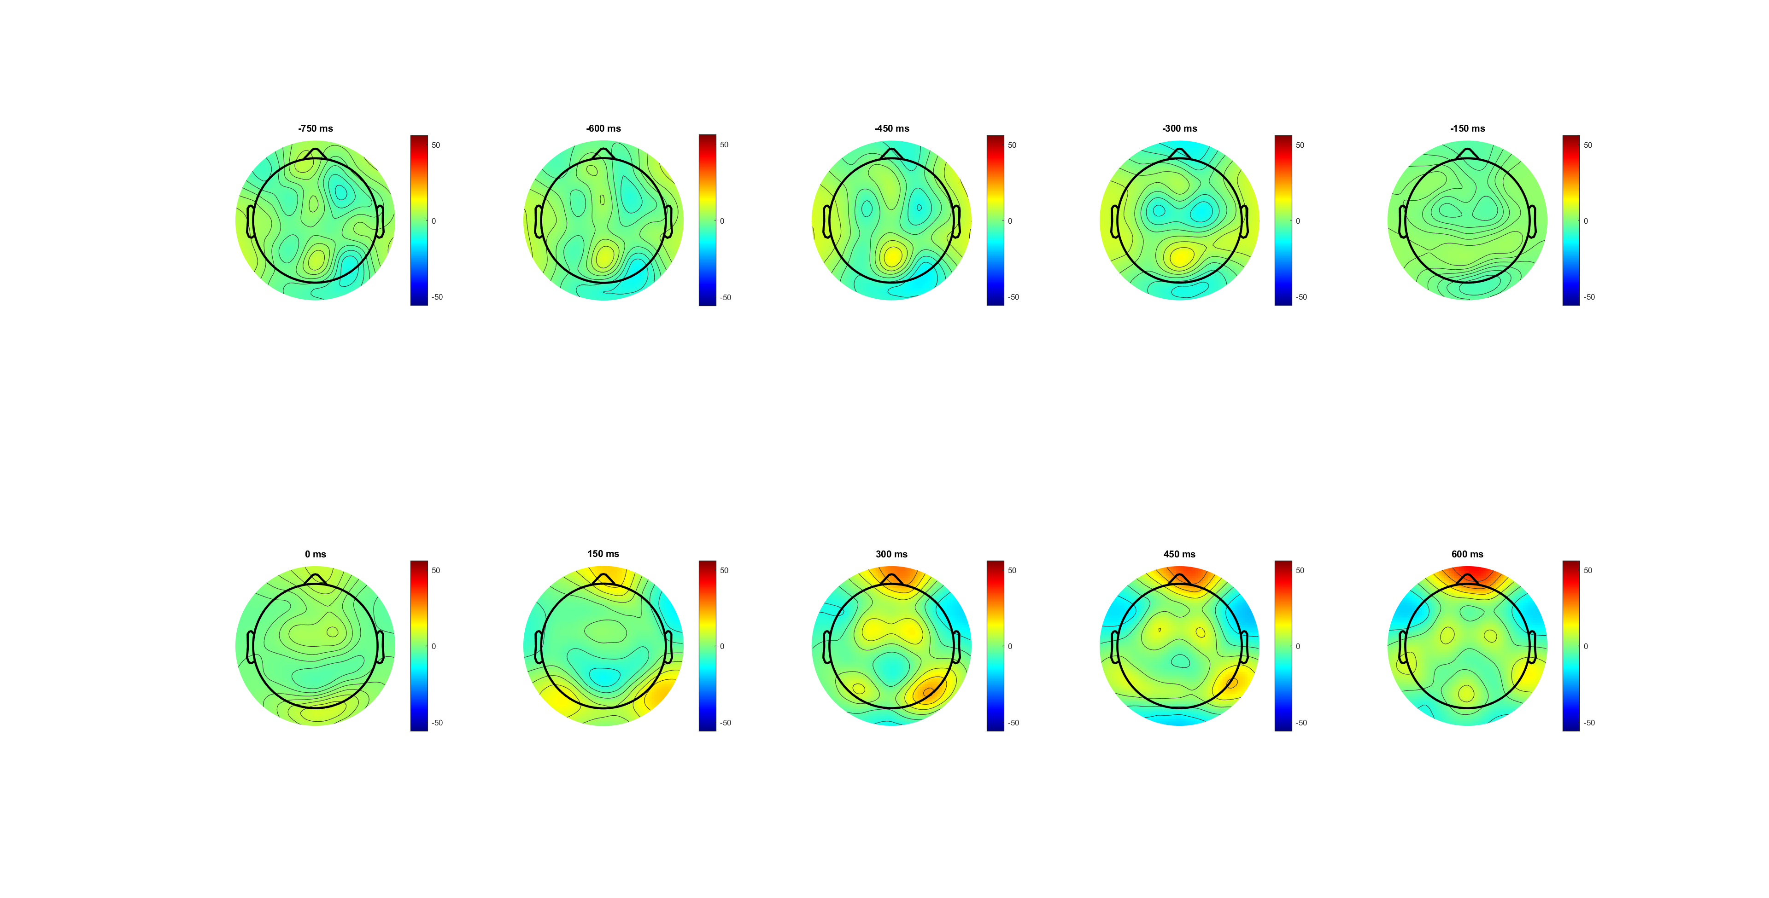
low (-750:600) see -300( smaller CPP)

Slide 35
FDI vs BCP correct (-188 before cue)
Same amplitude
BCP ~=40ms faster!!!!!!
(scalp plot) -300 and 150 300 patten?
Notes:
EEG_sorting_plot_SL_bb.m

Slide 36

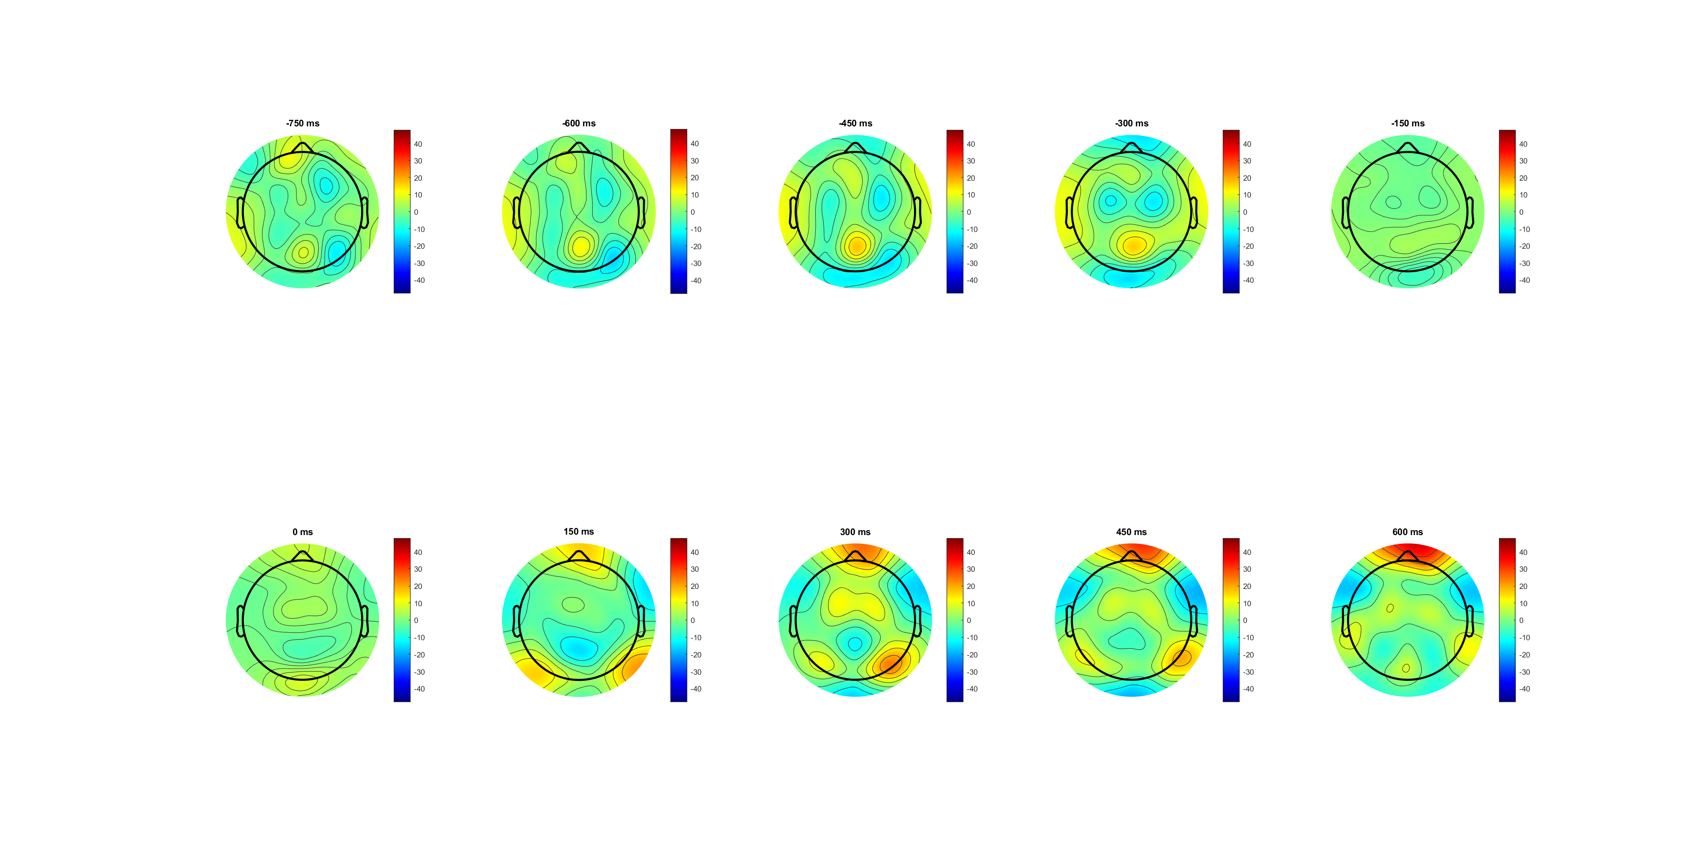

FDI (-750:600) see -300(CPP higher)

Slide 37


BCP (-750:600) see -300(CPP) motor area more concertanted

Slide 38
FDI vs BCP correct(L) wrong(R)
BCP faster acc in correct(L) and wrong!!!
BCP lower peak in wrong
Notes:
Pre evidence

Slide 39
FDI vs BCP correct high(0.14 left) low (0.07) right
Among correct trials
L: Same acc but BCP drops earlier and lower peak
R: BCP earlier acc (40ms); high peak

Slide 40
FDI vs BCP wrong high(0.14 left) low (0.07) right
Among wrong trials 200:200
L: BCP earlier and higher
R: FDI higher

Slide 41
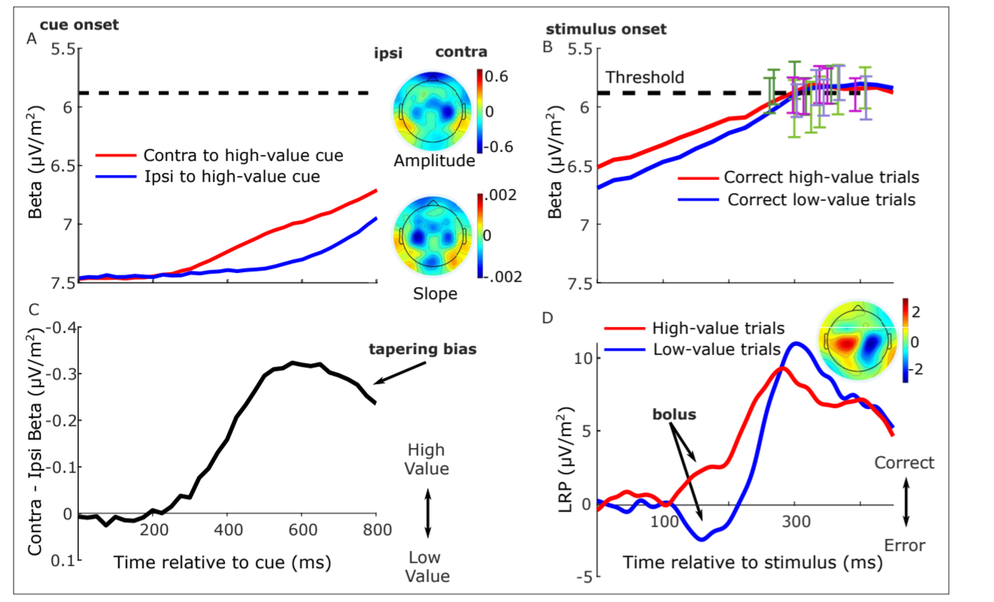
LRP analysis
SL -188 pre cue
RL - 188 pre cue
What’s the time of the scalp plot ( why 750ms)?

Slide 42
LRP correct-wrong
Right response larger amplitude
Correct larger than wrong
Start 300ms after stimuli
Right hand peaks faster and maintains longer
Scalp plot not observes (CPP too strong)

Slide 43
LRP High-low
High faster slop after 300ms
High-right(blue) have a shorter maintain period
We know there’s diff between correct vs wrong and high vs low, then check FDFI vs BCP

Slide 44
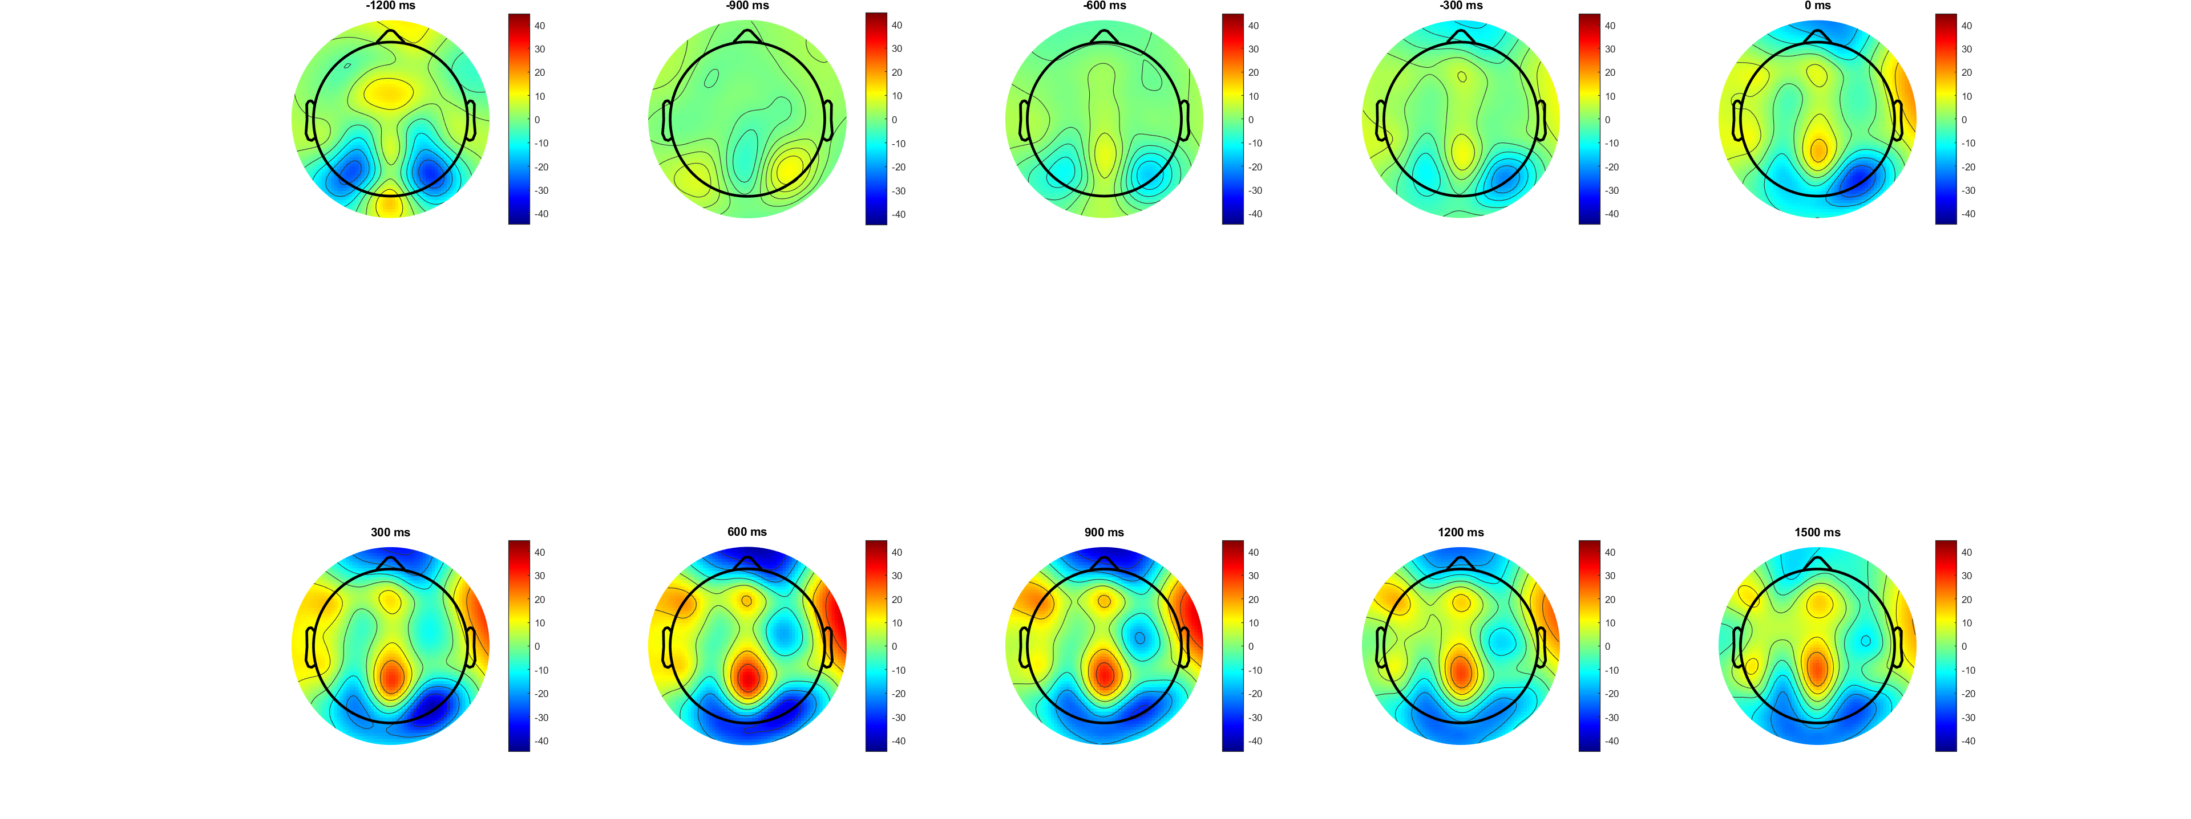

Right-correct
600-900 motor area most observious

Slide 45
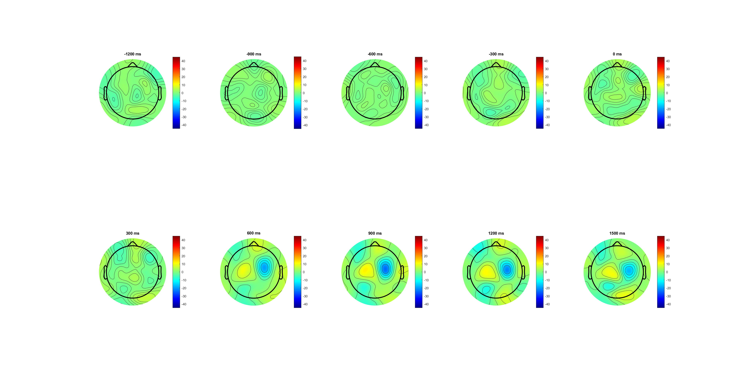

Left- right (correct) time too late(600ms?)

Slide 46
LRP FDI-BCP
In right: BCP is slightly higher and decrease slower than Fdi
* in CPP plot BCP is 40ms faster than FDI, but here the build- up 300ms seems same
Try more precise sorting / C3,C4 location to make the diff more observes
*want see diff in 0-1500 period

Slide 47
LRP FDI-BCP (Correct only)
BCP higher more observes in correct only trials
*but not sure why no observes diff in left response (BCP slightly lower)
Sorting more !

Slide 48
LRP FDI-BCP (Correct only+ only 0.14)
BCP higher amplitude, deeper slop

Slide 49
LRP FDI-BCP (Correct only+ only 0.14) C3C4+(115 54) more FDI （D19B22） C3c4 C3C4-(110 52) more BCP
Amplitude diff of L &R; (norm. Muscle size/ fine control/ priority )
C3C4+ is more symmetric
Use which location?

Slide 50
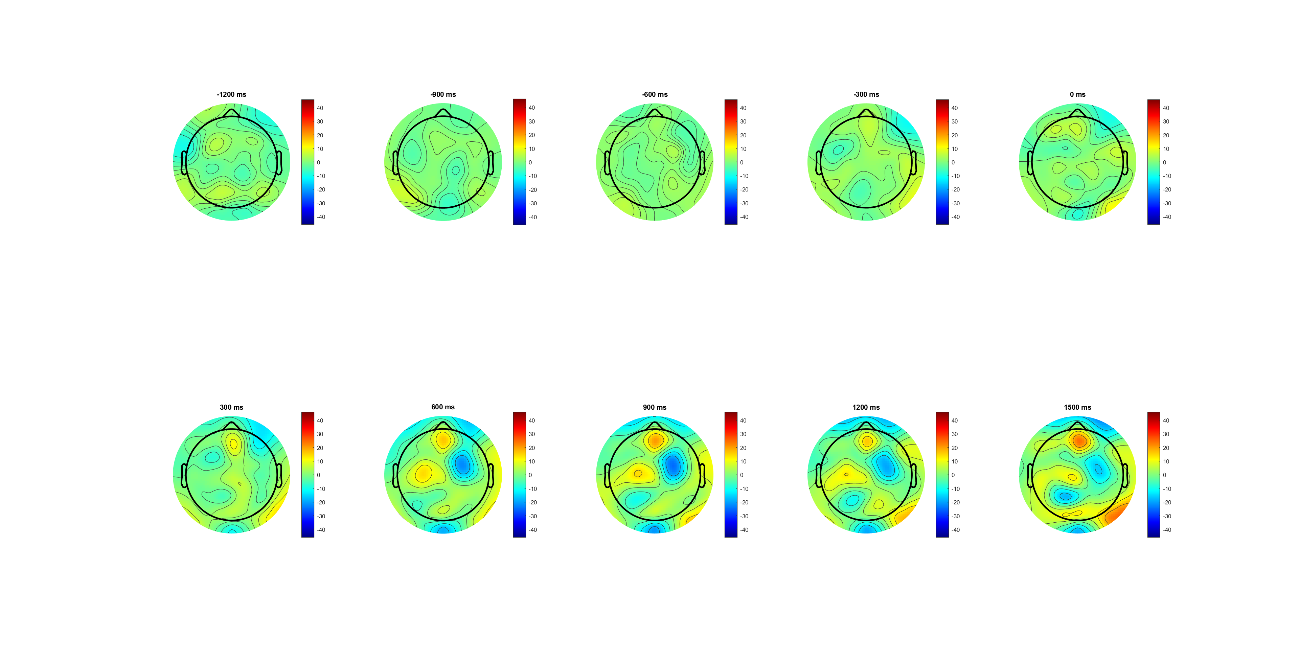
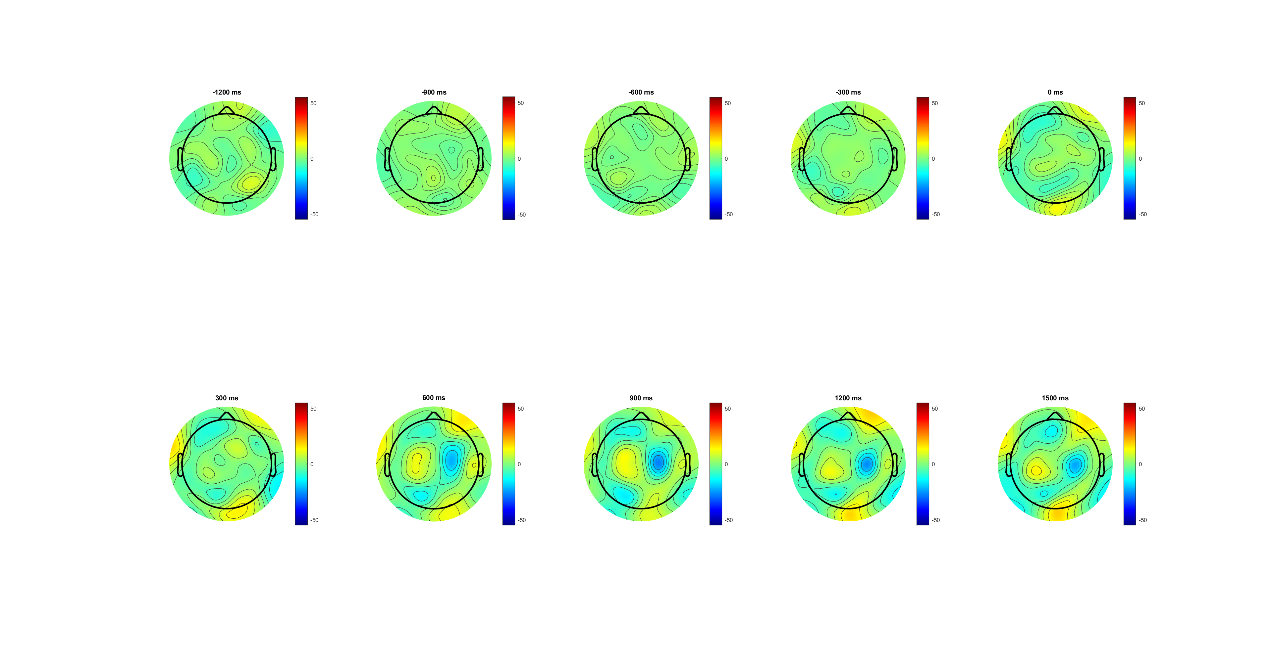
FDI Vs BCP left –right (correct, 0.14)
FDI
BCP
BCP little close to the centra; higher amplitude

Slide 51
LRP analysis
SL -188 pre cue
RL - 188 pre cue

Slide 52
No diff between Correct vs wrong
Right higher amplitude than left after -500-0.

Slide 53
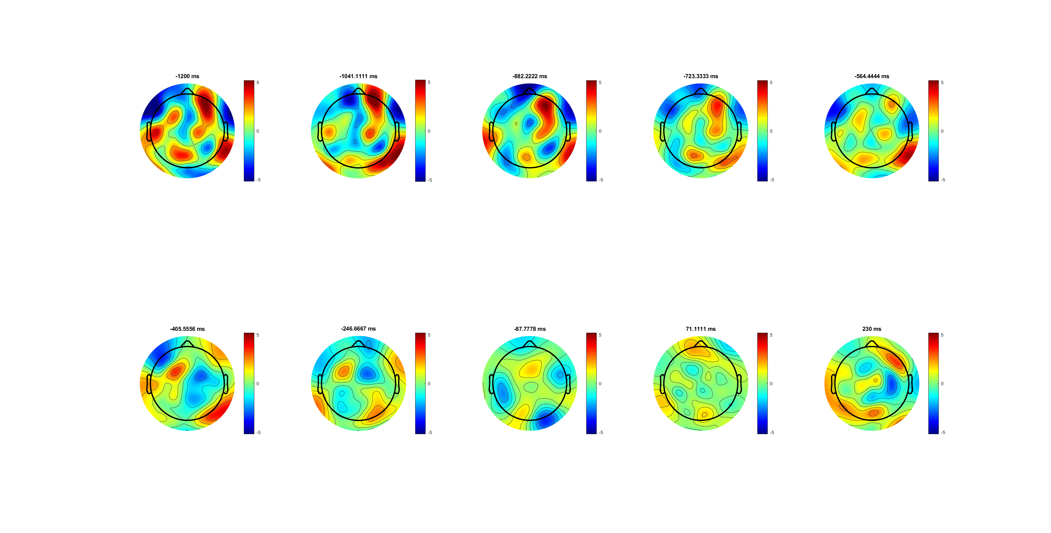
Changed color limit (-450 before end of trial)

Slide 54
No diff between high vs low
‘high’ higher amplitude than ‘low’ after -500-0.

Slide 55
BCP always lower than FDI
Right higher amplitude than left after -500-0.

Slide 56
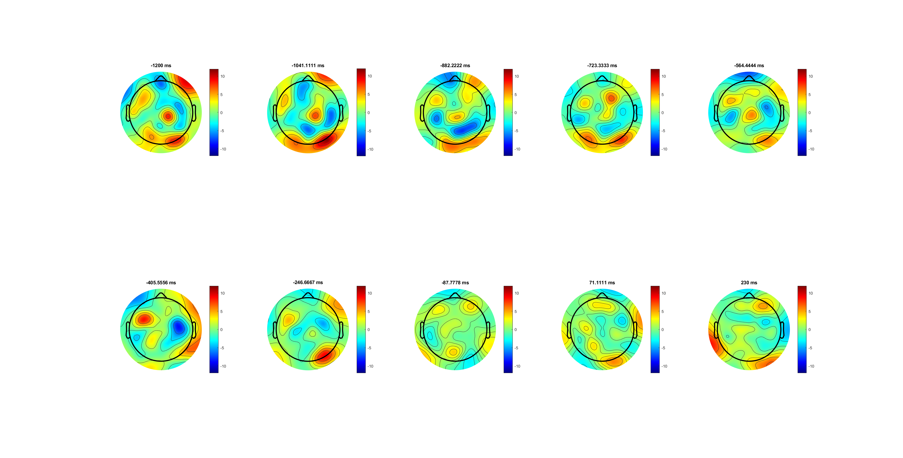

FDI
FDI wider!!!!
BCP close to the centra

Slide 57
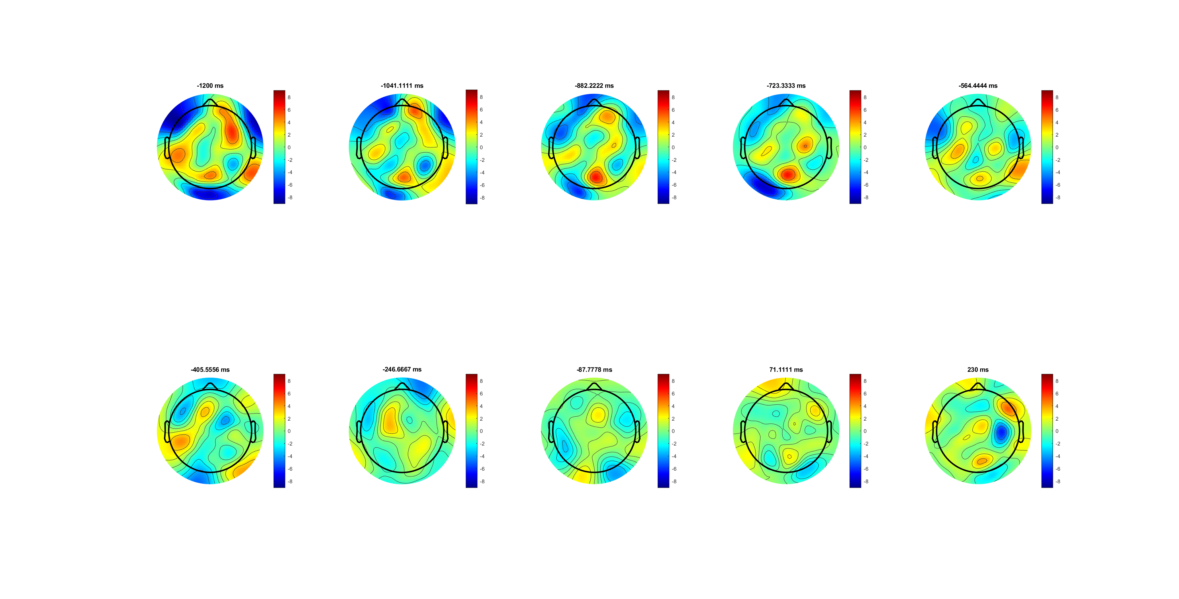

BCP (correct)

Slide 58
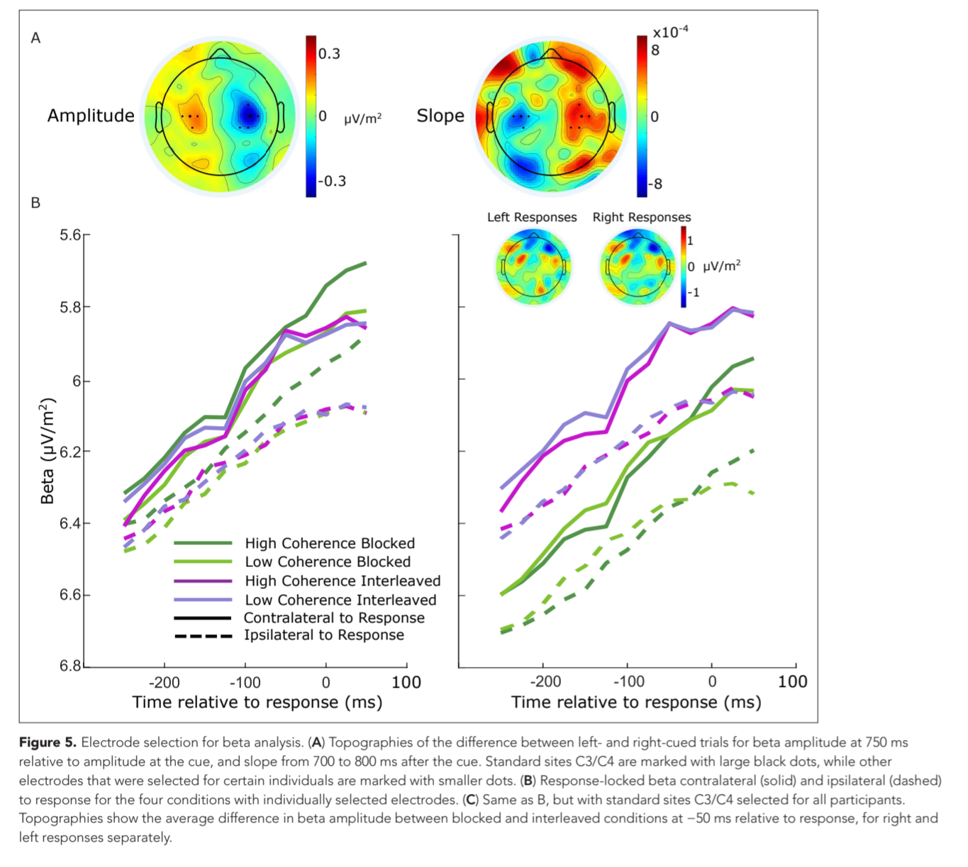
MB analysis
SL -188 pre cue (8-30Hz)
RL -188 pre response (12-30Hz) without Mu
Time for scalp plot?( why 750ms and slop?)

Slide 59
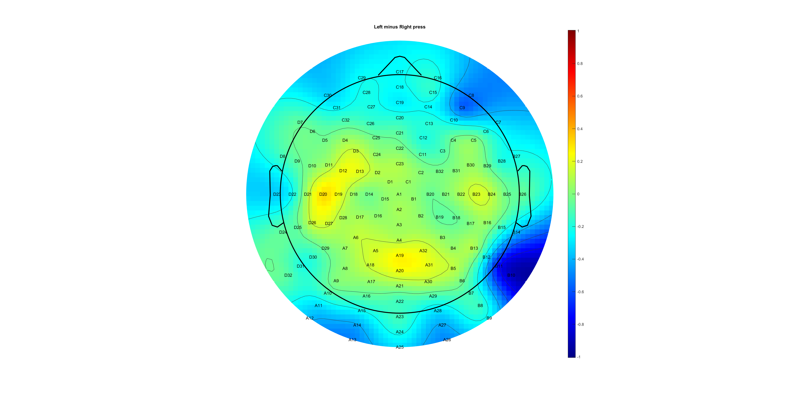
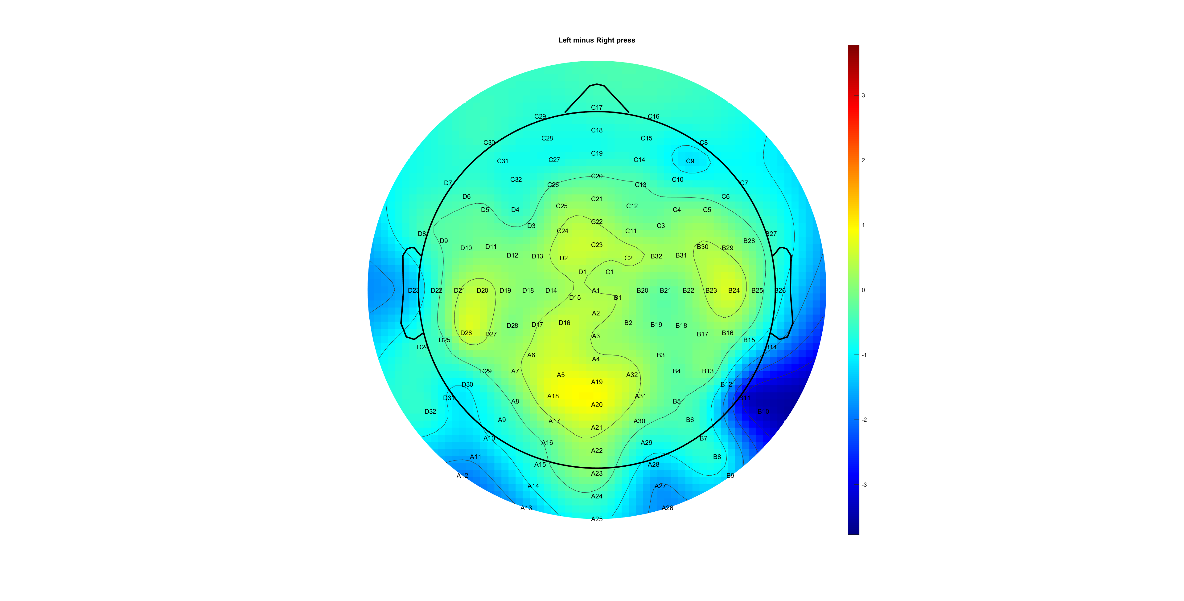
Left- right press (correct(L) vs wrong(R) ) t=400 D20 and B23
Amplitude too small? (wrong amplitude is larger)
Only see MP at correct trials

Slide 60
Higher MB amplitude when response is wrong
Right hand lower MB (diff. peak at 400ms)
Beta band decrease more amplitude when correct

Slide 61
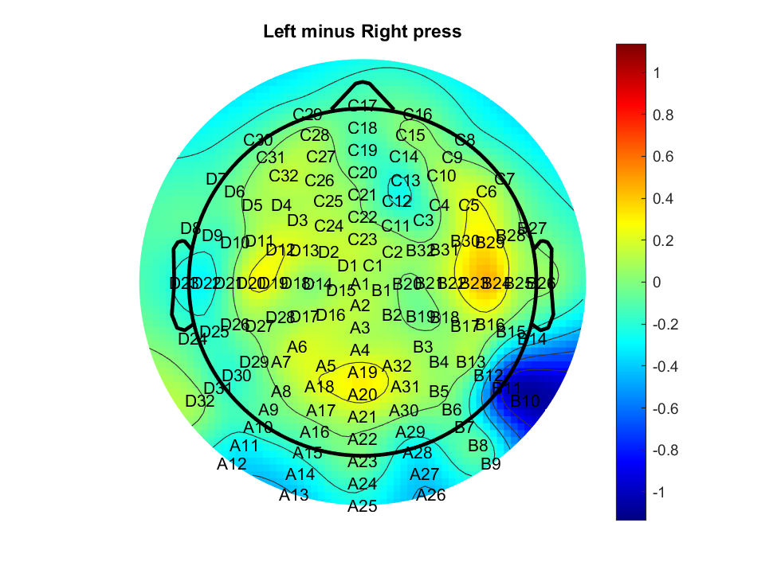
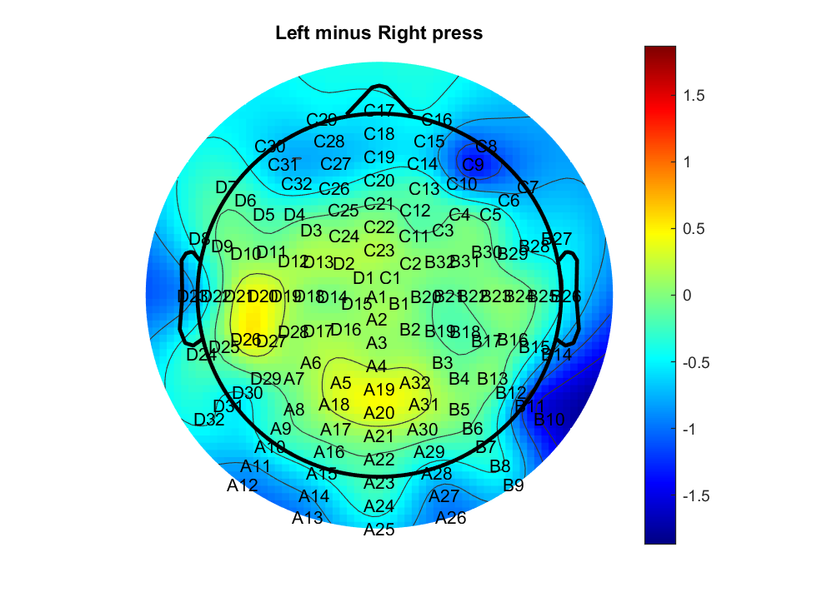
Left- right press (0.14(L) vs 0.07(R) ) t=400 D20 and B23
Low 0.07/ wrong response have higher MB amplitude
Diff

Slide 62
Easy task lower MB (diff. peak at 400ms)
Beta band decrease similar for 0.14 and 0.07

Slide 63
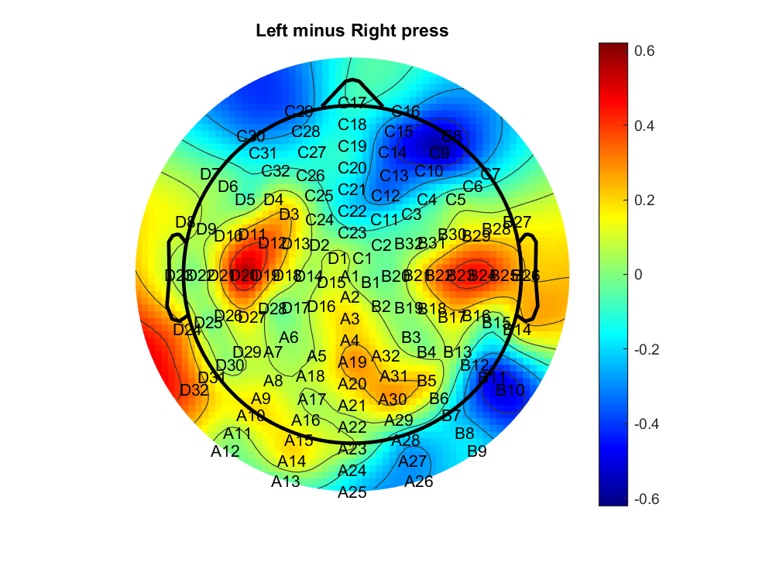
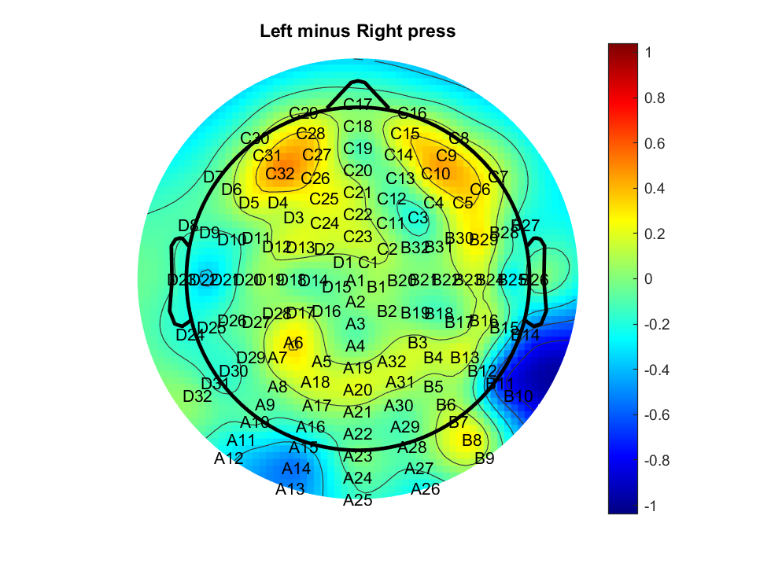
Left- right press (FDI(L) vs BCP(R) ) t=400 D20 and B23

Slide 65
summary
SL and RL: Wrong/ low 0.07 have higher MB amplitude?
SL and RL: BCP higher MB amplitude, but no observious Motor pre found
SL only: Right hand MB amplitude lower for correct/ high 0.14

Slide 66
MB analysis
SL -188 pre cue (8-30Hz)
RL -188 pre response (12-30Hz) without Mu

Slide 67
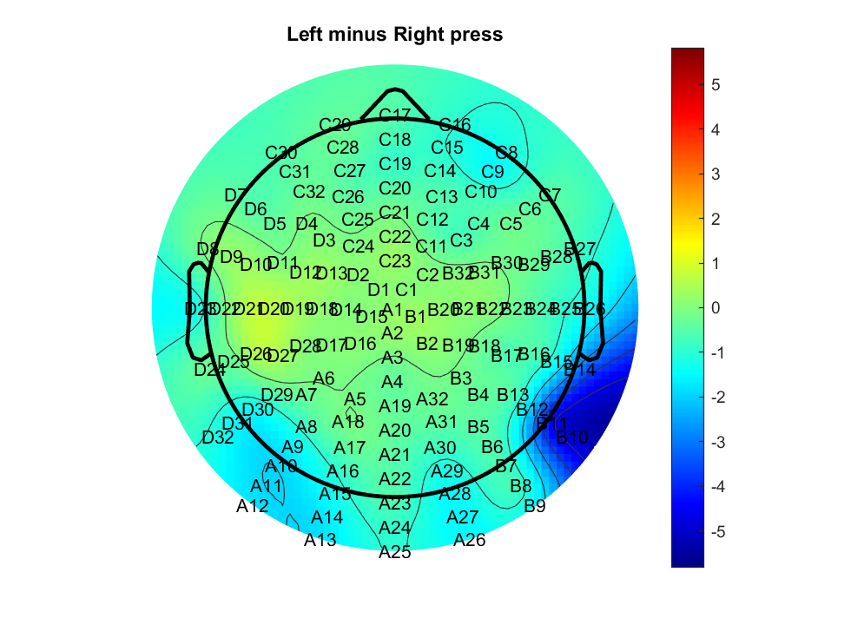
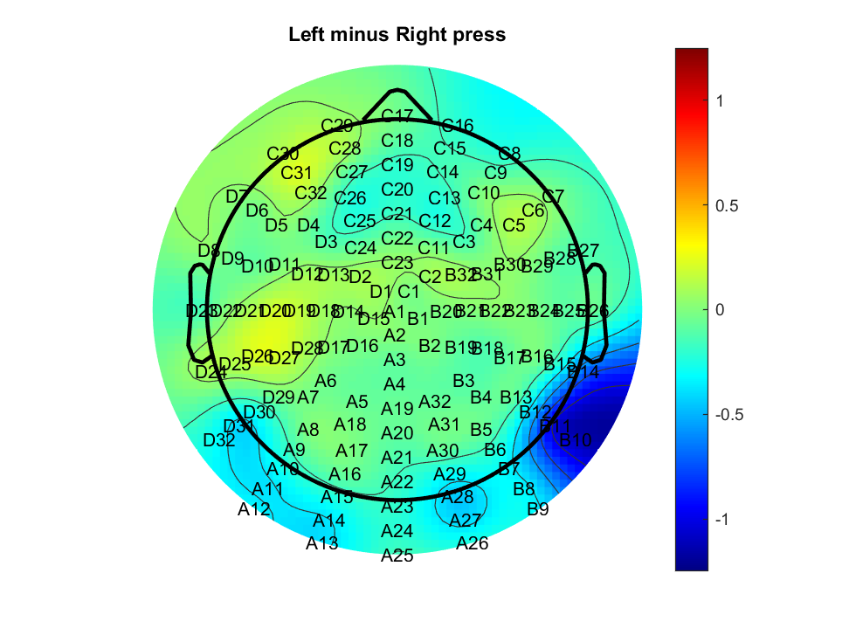
Left- right press (correct(L) vs wrong(R) ) t=-100 D20 and B23

Slide 69
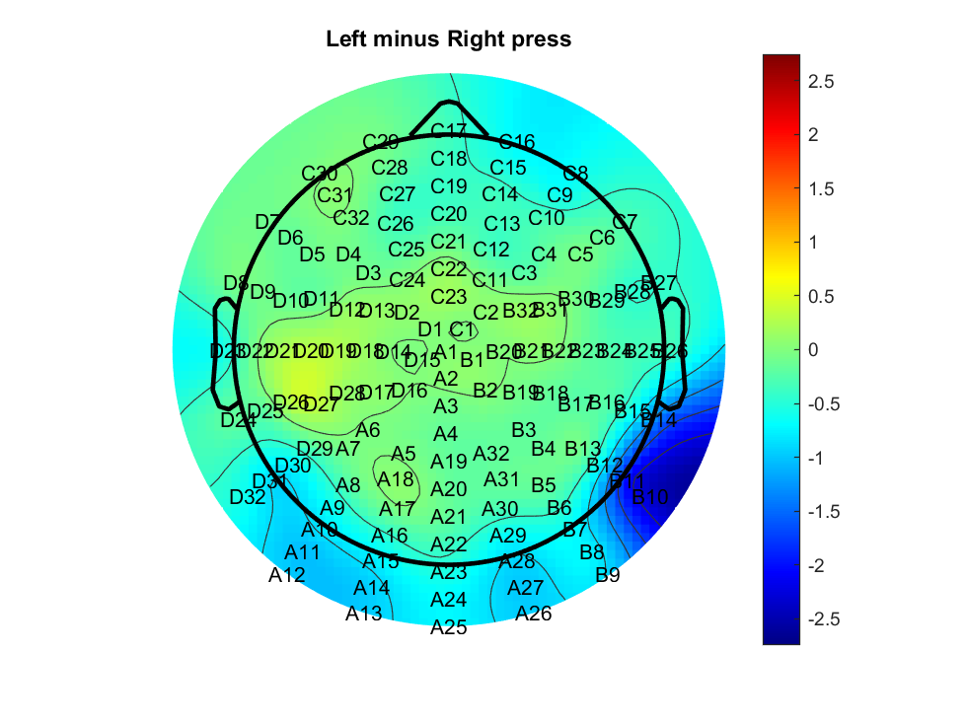
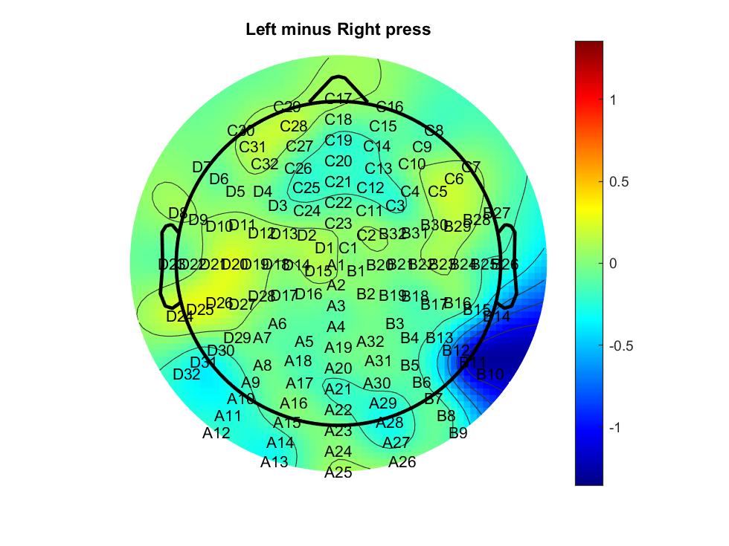
Left- right press (0.14(L) vs 0.07(R) ) t=-100 D20 and B23

Slide 71
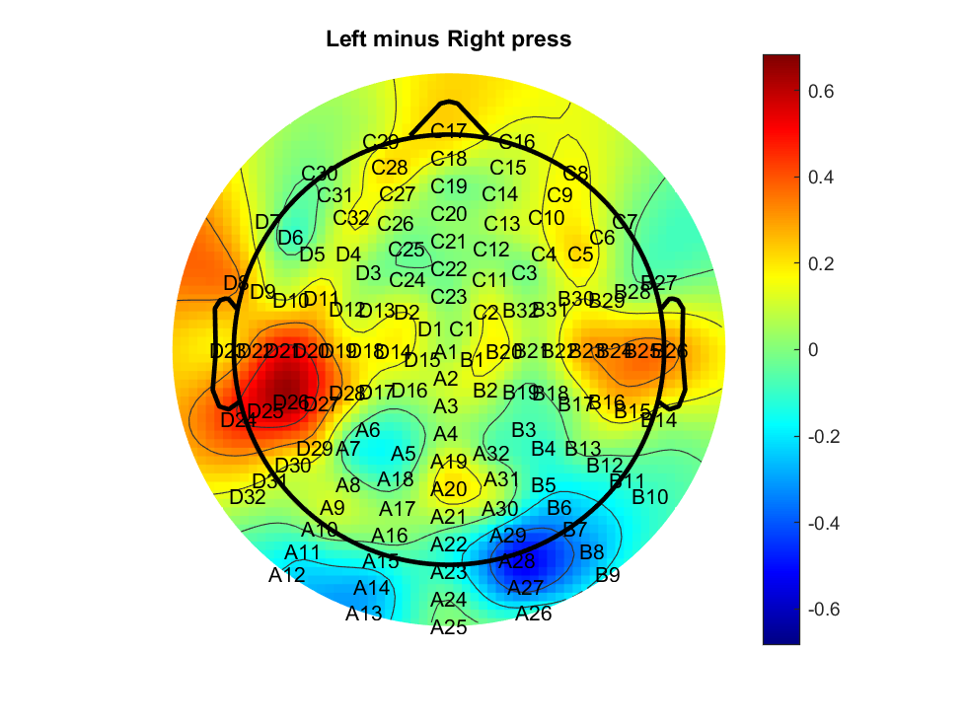
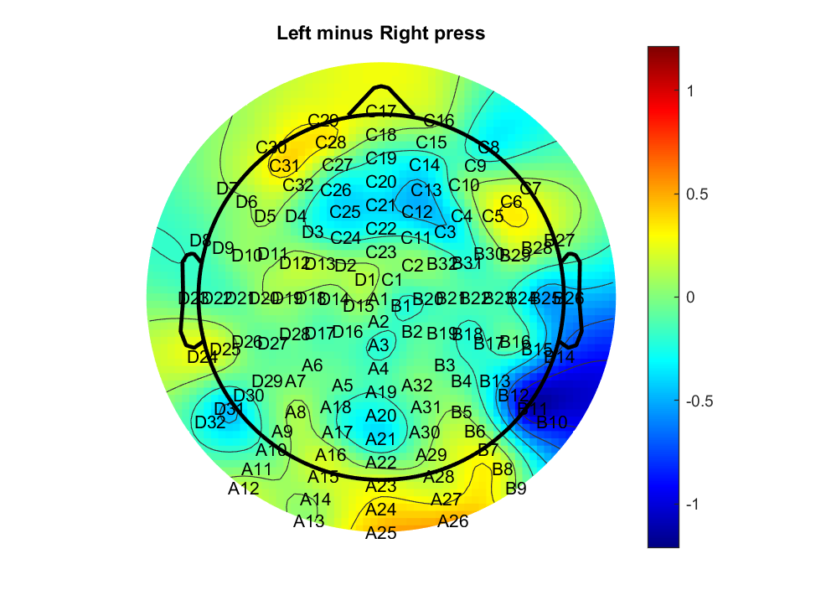
Left- right press (FDI(L) vs BCP(R) ) t=-100 D20 and B23

